Slide 1
.com
Internet speed test
Sergey Fedorov
RIPE 74
Budapest, Hungary
May, 2017

Slide 2
Who
am I?
Sergey Fedorov
Senior Software Engineer
4 years at Netflix
Open Connect monitoring system
QoE/traffic analysis tools
FAST.com
API acceleration using Open Connect
Notes:
Intro

Slide 3
Who
am I?
Sergey Fedorov
Notes:
Hobbies

Slide 4
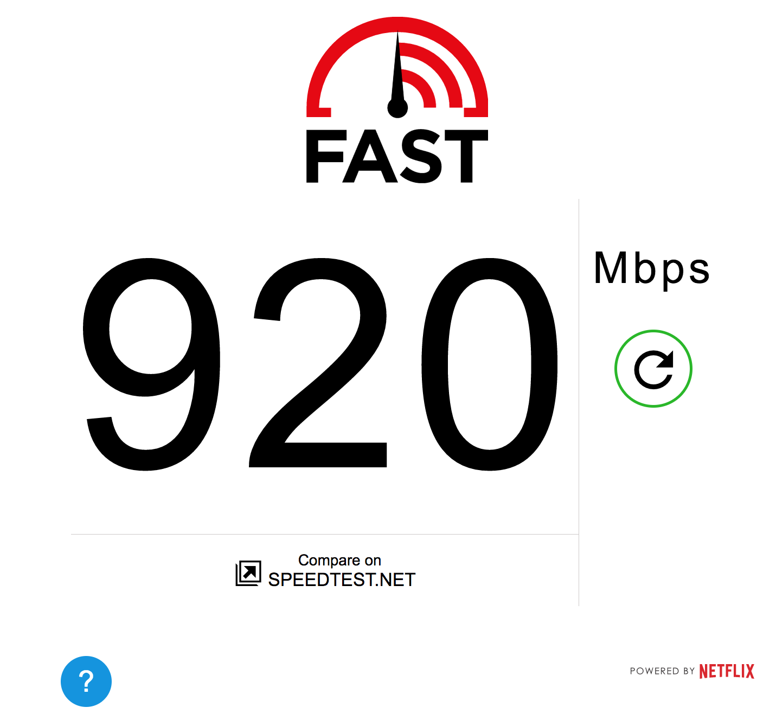
vs
Measurement & Ranking of NETFLIX’s streaming application performance across ISPs*
Measurement of the effective speed of ANY user
* The Netflix ISP Speed Index lists the average prime time bitrate for Netflix content streamed to Netflix members during a particular month

Slide 5
Goals
Simple UX
Lightweight
Fast and reliable
Device support
Represent real usage scenarios

Slide 6
Why
Netflix?
Experience in the field
Up to 35% of Internet traffic
Global infrastructure

Slide 7
Open Connect Network

Slide 8
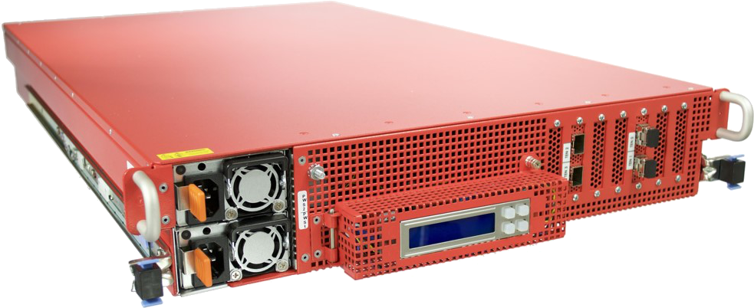
OCAs aka Open Connect Appliances
Space/Power optimized
10/40/100 Gb/s interface
FreeBSD
Gizmodo, “This box can hold an entire Netflix”

Slide 9
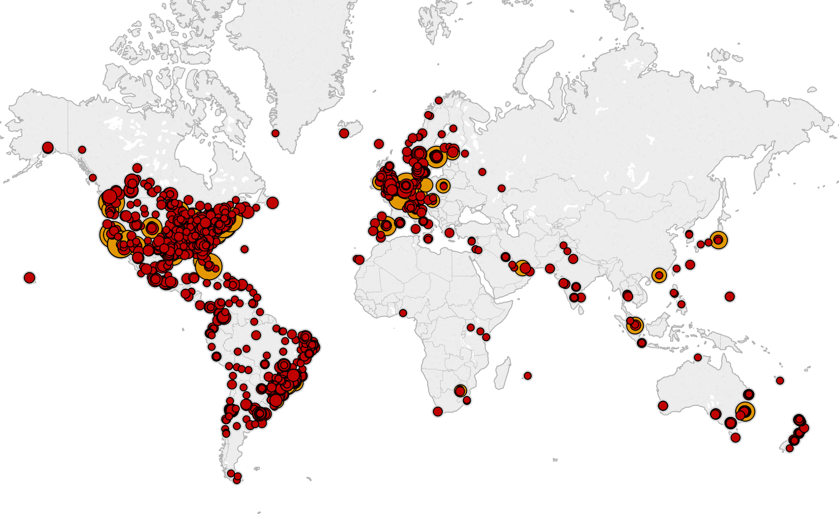

Slide 10
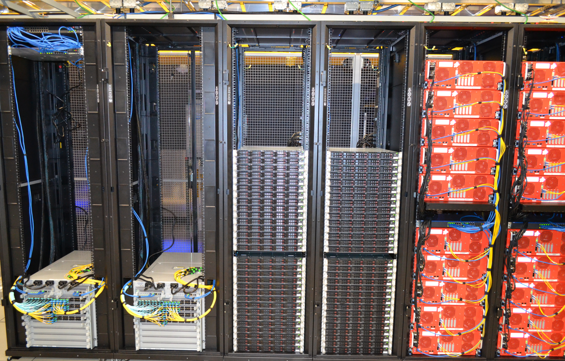
Network
Internet Exchange
PNI / Transit
ISP embedded

Slide 11
Control Plane
End-user content request router
Steer to an OCA based on:
client location
network conditions
server utilization
content distribution

Slide 12
The Open Connect Team

Slide 13
Open Connect @RIPE 74
Aaron Klink
Nina Bargisen
Samer Abdel-Hafez
Mike Peterson
Javed Vohra
Nat Morris
Sergey Fedorov

Slide 14
FAST.com
Minimalistic UX
Download speed as most important measure
Auto-start
Wide browsers/device support (tested)
IE8+, Safari 4+, Firefox 4+, Opera 12+
iOS 4+, Android 4+
(Anecdotal) successful measurements from:
Cameras
eReaders
watches

Slide 15
How does FAST.com work?

Slide 16
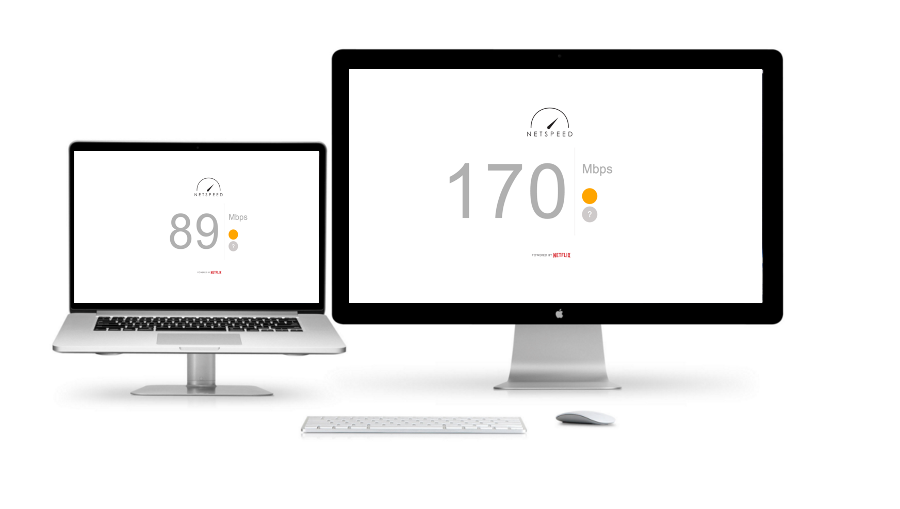
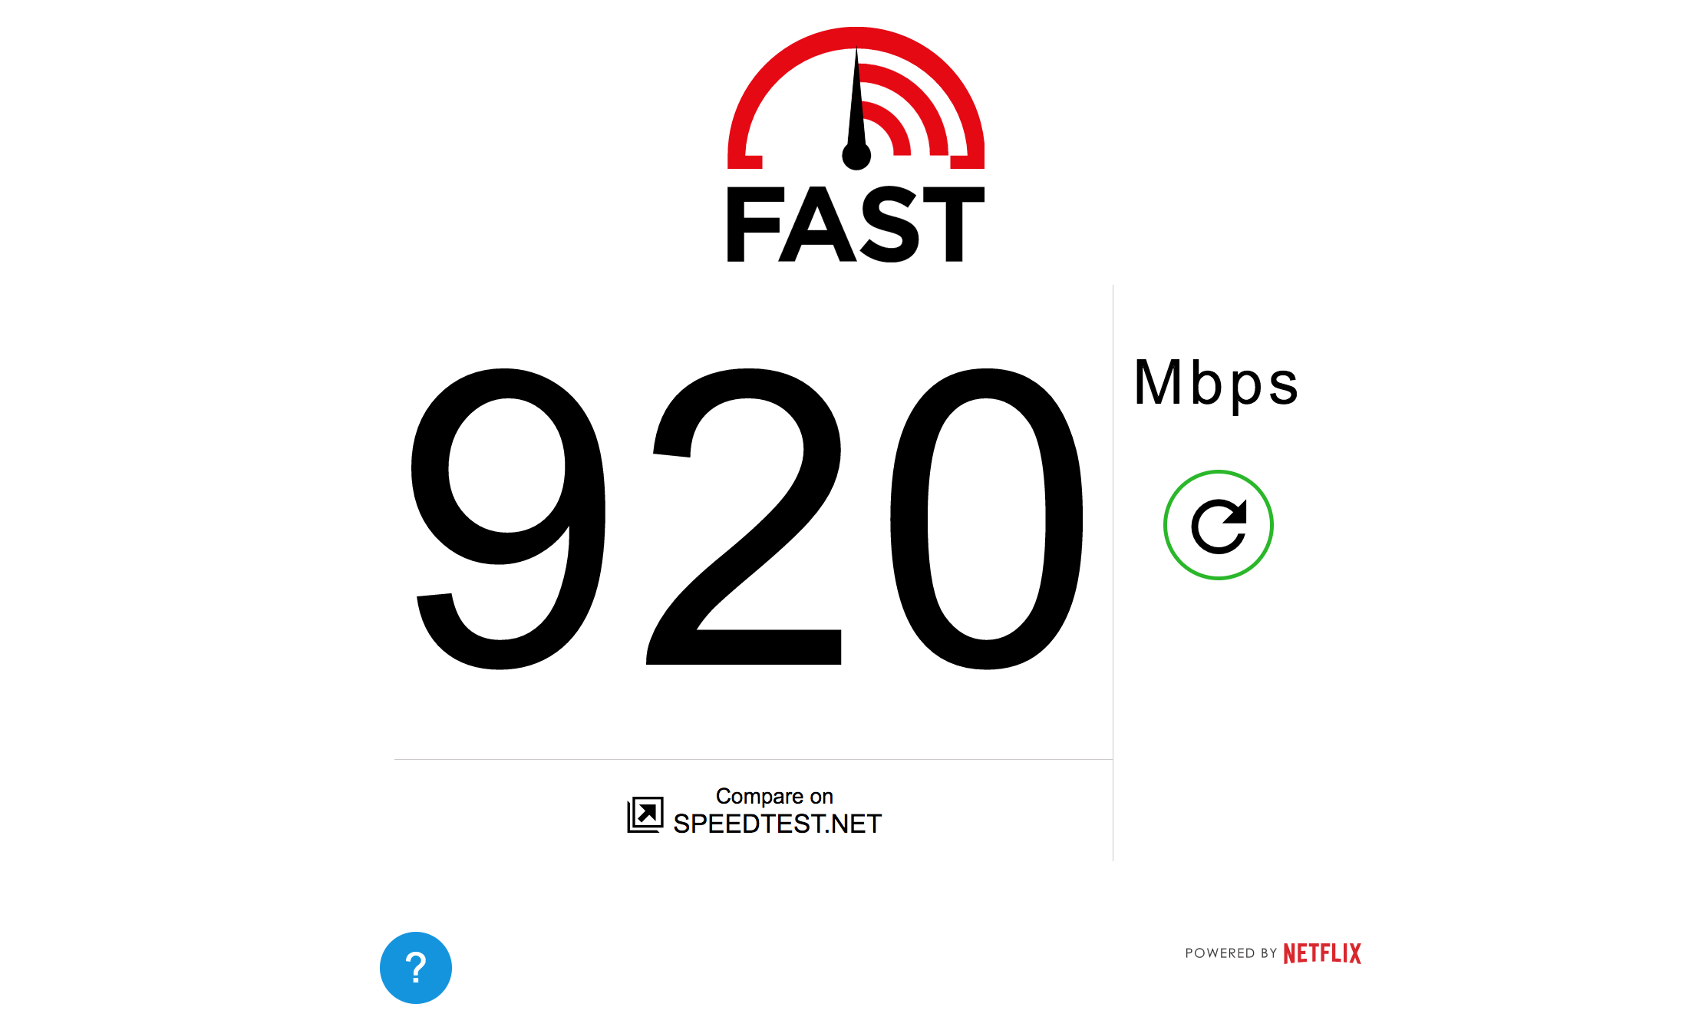
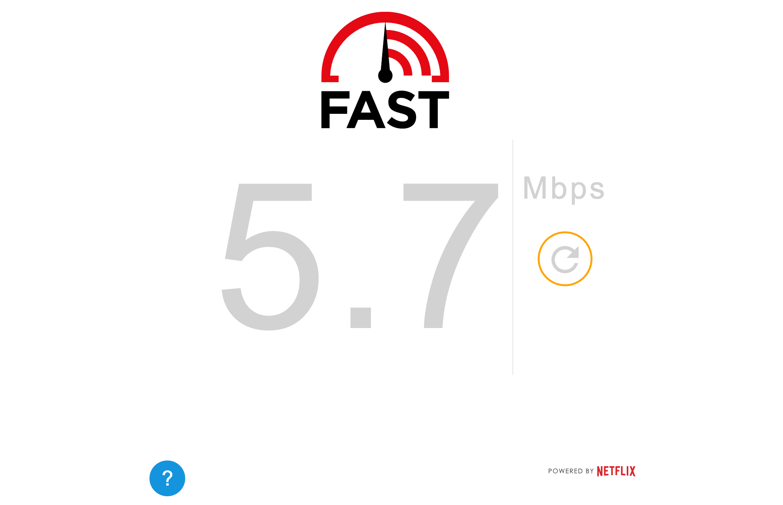
Step 1: Load HTML/JS client
CDN
25KB page size
Scalable UI
JS/HTML5
Accept-Language: en_US
Fast.com
Fast.com
Fast.com
Test engine

Slide 17
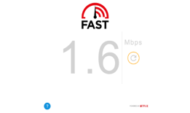
Step 2: Get a list of nearby OCAs
Steering
Select servers that are:
healthy
close
on the best network path
api.fast.com
IPv6 is used
whenever possible
2
OCA
Edge
3
1
URL_1
URL_2
...
GET list of OCAs
http(s)://api.fast.com/oca/speedtest
4

Slide 18
Step 3: Construct the OCA url
http(s)://<oca_hostname>/speedtest/range/<start>-<end>
OCA
Test file - 25MB
hash/token + expiry
HTTPS only!

Slide 19
Test client
Clients
Events:
Progress
Result
Connection stats
Commands:
Start
Stop
Orchestrator
Initializes connectors, schedules downloads
Stopper
Time to stop the test?
Engine
Download stats:
bytes
[start, end]
Aggregator
Measurements -> speed
Download request:
url
Connectors
xhr
websockets
OS native
npm

Slide 20
Step 4: Concurrent downloads
Conn #1
Conn #2
Conn #3
GET
/range/0-<size1>:
GET
/range/0-<size2>:
GET
/range/0-<size3>:
Thread 1
Thread 2
Thread 3
measurements
measurements
measurements
When throughput is low, don’t want connections to compete for limited bandwidth
>500Kbps
>1Mbps
* Actively experimenting with thresholds and number of connections

Slide 21
Step 4: Concurrent downloads
Conn #1
Conn #2
Conn #3
GET
/range/0-<size1>:
GET
/range/0-<size2>:
GET
/range/0-<size3>:
Thread 1
Thread 2
Thread 3
measurements
measurements
measurements
Received measurements:

Slide 22
How to aggregate results?
Exclude TCP ramp-up
Dynamically define ramp-up period
Show goodput
Reflects real customers experience
Protocol overhead is hard to get right from the browser - more work needed here

Slide 23
How long to run the test?
Track how the speed changes
Compute a delta within sliding window of last measurements
Stop the test once the delta is within a few %
Past ramp-up:
compute average speed
don’t exclude any data points

Slide 24
Step 5: Compute speed
Conn #1
Conn #2
Conn #3
GET
/range/0-<size1>:
GET
/range/0-<size2>:
GET
/range/0-<size3>:
Thread 1
Thread 2
Thread 3
measurements
measurements
measurements
Received measurements:
Instant snapshots:
In-progress/final measurement:

Slide 25
Usage

Slide 26
Fastest
measured
speed?
3.2 Gbs
ASN 134171, Singapore

Slide 27
ASNs
coverage
IPv4
40k ASNs 5k with 1k+ tests 1k with 10k+ tests
IPv6
3k ASNs 1.2K with 1k+ tests 0.5K with 10k+ tests

Slide 28
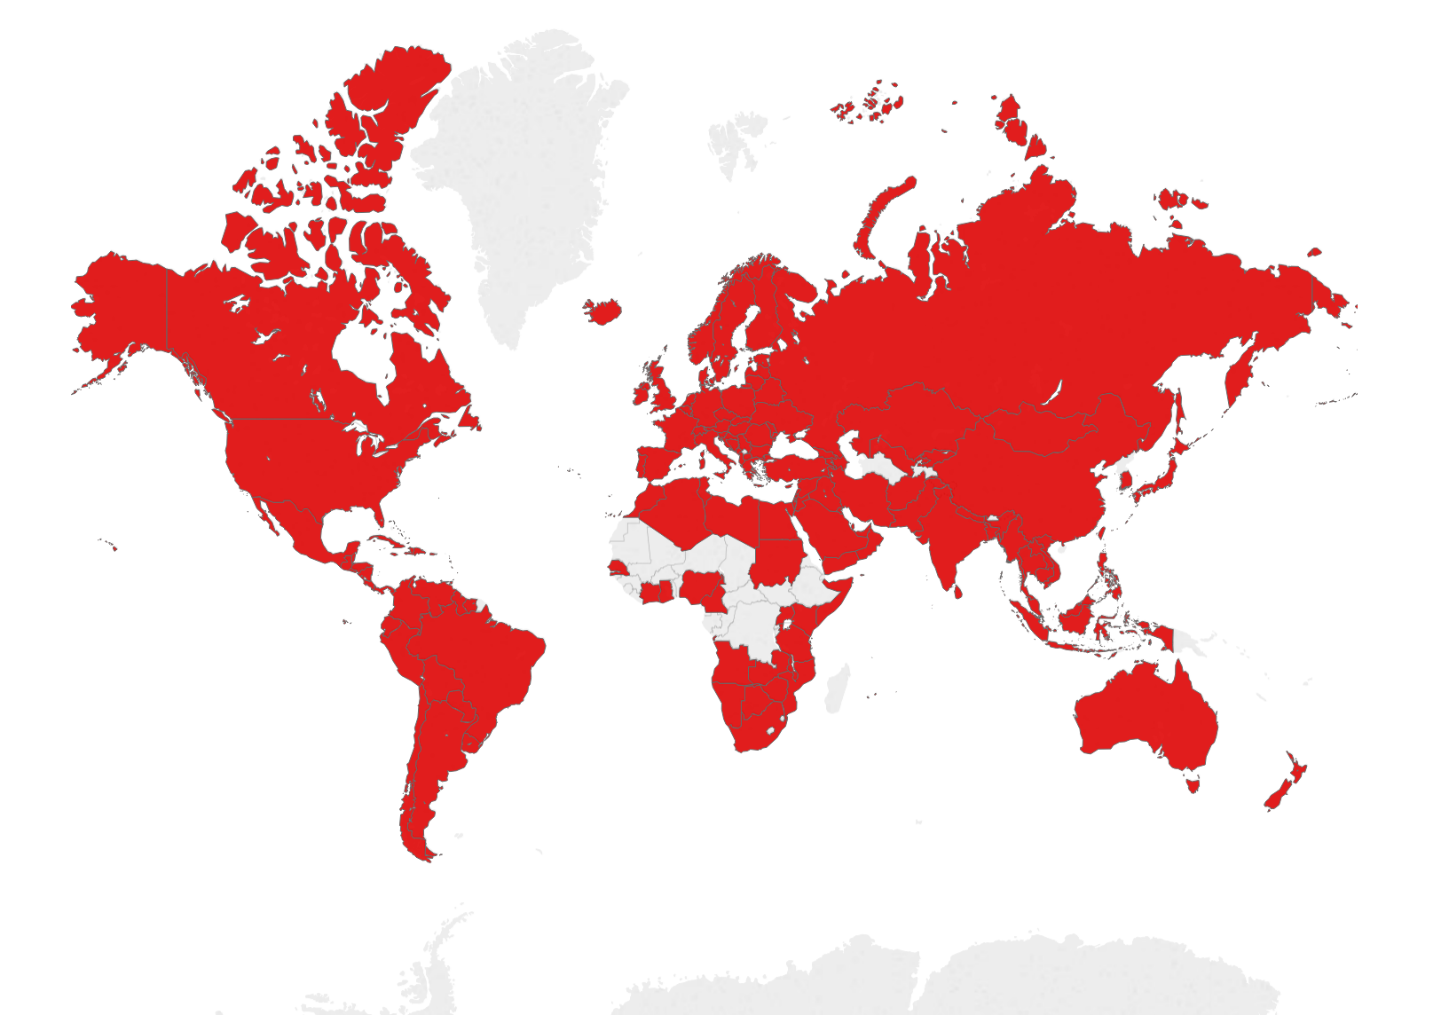
10K+
tests
per
country
71%
139 countries

Slide 29
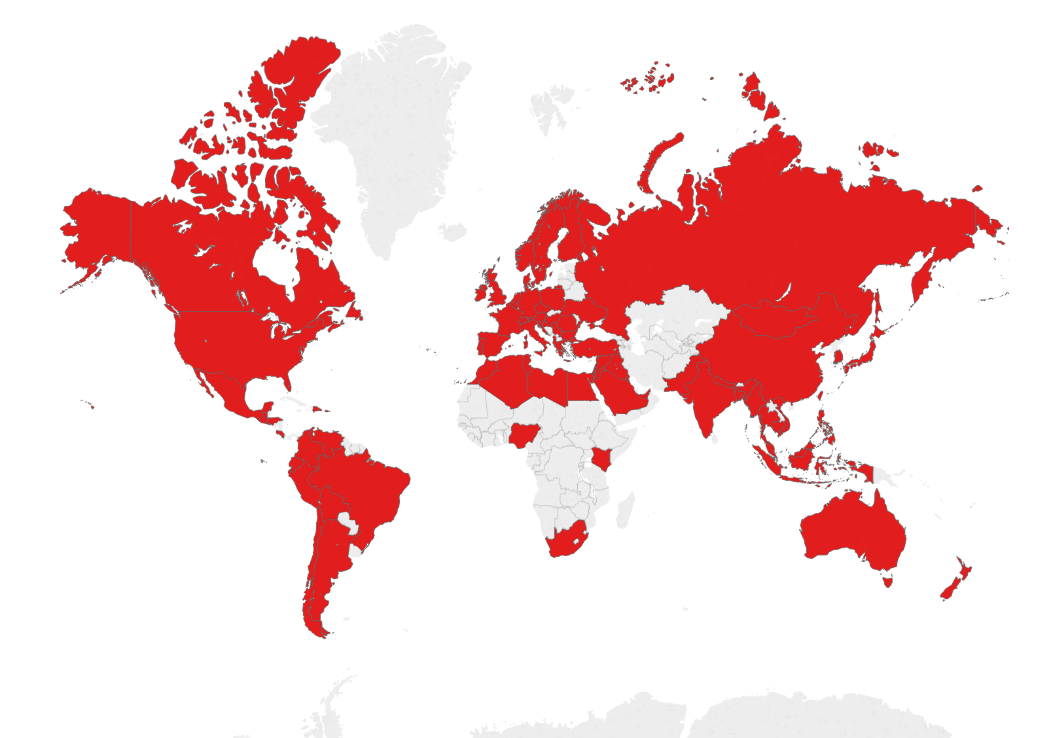
100K+
tests
per
country
41%
79 countries

Slide 30
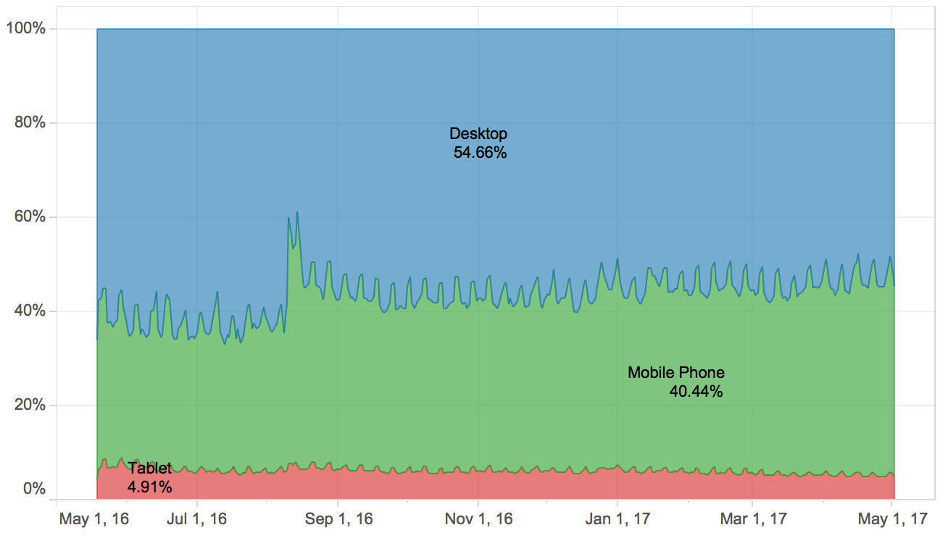
Mobile
vs
Desktop

Slide 31
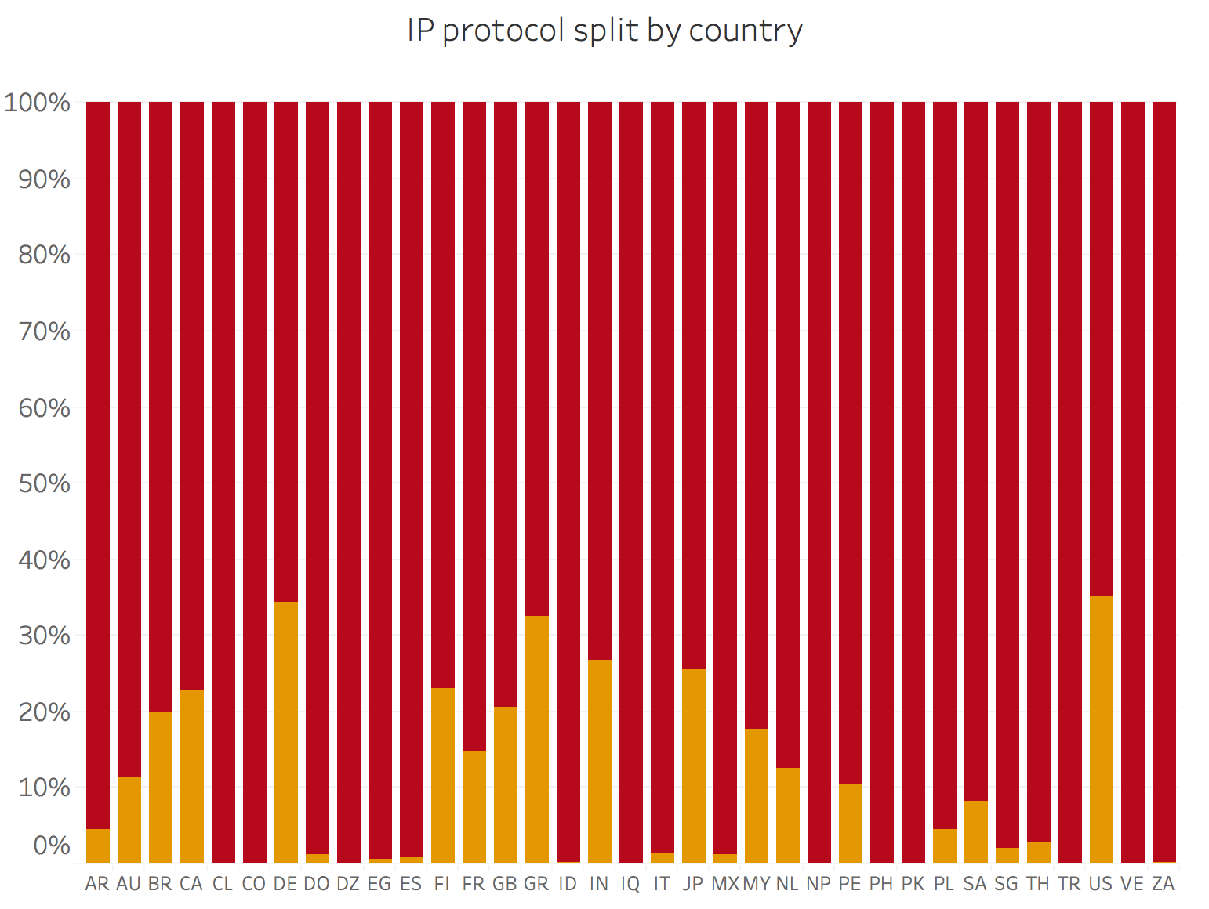
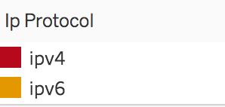
IPv4
vs
IPv6
coverage

Slide 32
Summary & Next steps
Simple approach worked well
More tweaks in the measurement methodology
Number of connections
Stop condition
Collect low-level metrics from servers
Correlating FAST.com results with other data sources
Can we correlate with probe measurements?
How much variation does browser add?

Slide 33
FAQ
Will you ever add latency/upload measurements?
Yes
Can I embed FAST.com test on my website?
Not at the moment, but talk to me regarding your use cases
Are you going to publish test results
No plans for now

Slide 34
Questions?
Sergey Fedorov
sfedorov@netflix.com

Slide 35
Thank you!
Sergey Fedorov
sfedorov@netflix.com

