Slide 1
Challenges in Digital Archeology
Paul Thornton
paul@prtsystems.ltd.uk
RIPE74
Budapest
12 May 2017
A very brief walk around some of the problems associated with researching Internet history.

Slide 2
What’s the challenge?
Problems I’ve encountered whilst working on UK Internet history recently:
Failing electronics.
Obsolete devices and interfaces.
Physical media problems.
PRTsystems
www.prtsystems.ltd.uk
Notes:
This is equipment that is around 18-20 years old.
So not very very old.
And we already have problems.

Slide 3
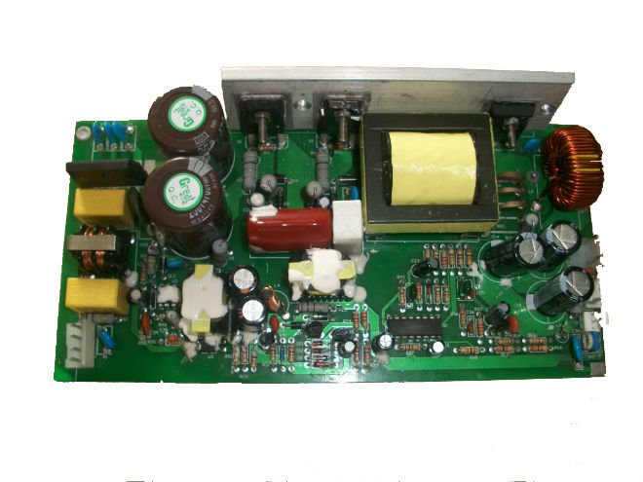
Time isn’t kind to the electronics
Power supply capacitors dry out.
Can cause PSU to blow up equipment.
PRTsystems
www.prtsystems.ltd.uk

Slide 4
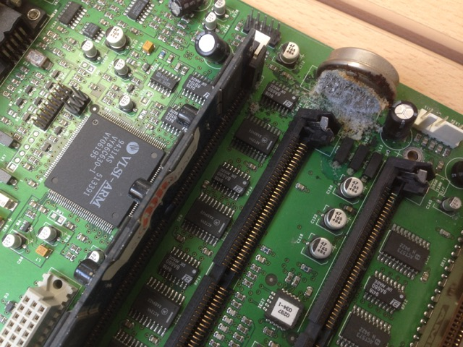
Time isn’t kind to the electronics
PCB mounted batteries leak...
destroying circuits and nearby components
PRTsystems
www.prtsystems.ltd.uk

Slide 5
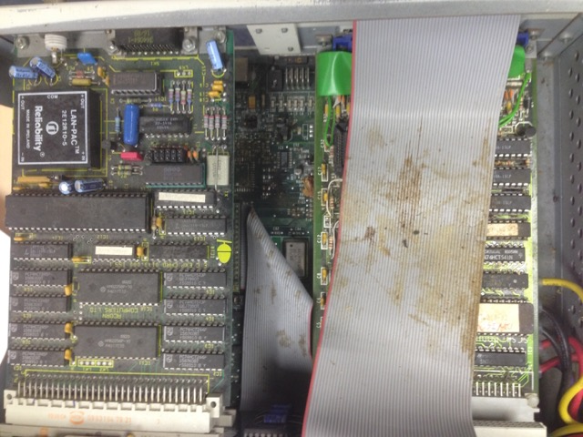
Time isn’t kind to the electronics
Mice can move into old hardware.
And leave gifts on your SCSI bus!
PRTsystems
www.prtsystems.ltd.uk

Slide 6
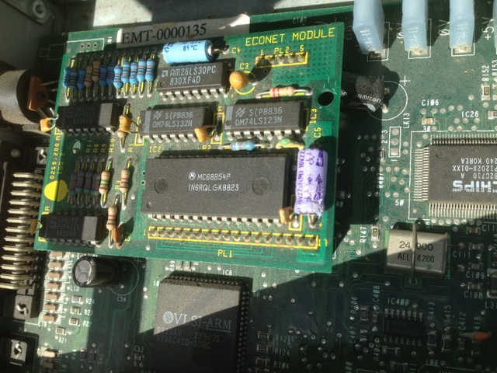
Time isn’t kind to the electronics
The same mice needed to eat as well.
Capacitors on old network cards are tasty!
PRTsystems
www.prtsystems.ltd.uk

Slide 7
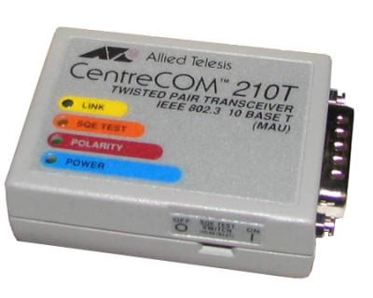
Hardware is very quickly old too
Want to connect an old device to the network?
Do you have a port that will do 10M half-duplex?
PRTsystems
www.prtsystems.ltd.uk

Slide 8
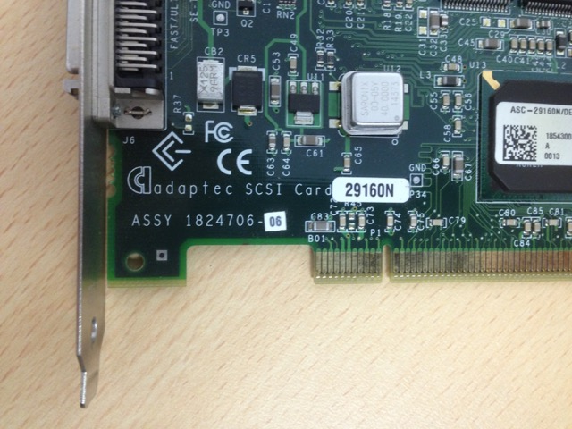
My PC doesn’t have that port
Need an interface card for some old drive?
SCSI – great that’s standard. But PCI!
PRTsystems
www.prtsystems.ltd.uk

Slide 9
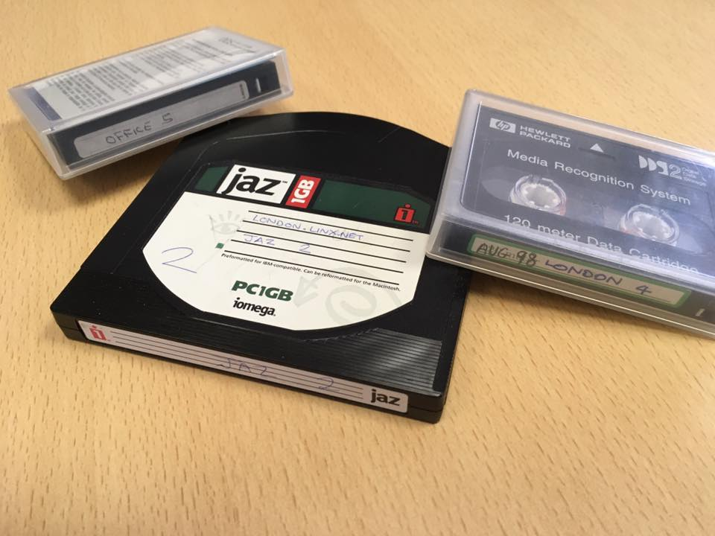
How do I read these?
DDS2 won’t work in a modern DAT drive.
Where did Jaz drives go?
PRTsystems
www.prtsystems.ltd.uk

Slide 10
Physical media degrades...
Great. Found compatible hardware, but...
dd: /dev/nsa0: Input/output error 0+0 records in 0+0 records out 0 bytes transferred in 48.053826 secs (0 bytes/sec)
PRTsystems
www.prtsystems.ltd.uk
Notes:
It took it 48 seconds to establish that things were not going to work out!
Think about long-term data storage.

Slide 11
Is there any hope?
One thing that was both usable and reliable was an old IBM 1G hard drive from 1994.
It is SCSI-1 – very slow, but still works with a modern SCSI interface.
Hard drives are likely to be better than tapes for long term storage.
PRTsystems
www.prtsystems.ltd.uk

Slide 12
Is there any hope?
Try to use the lowest common denominator for things like filesystems (eg: FAT32) or well known formats like tar/zip.
Avoid proprietary technology.
Make image files of discs.
Keep data live on up-to-date media.
PRTsystems
www.prtsystems.ltd.uk
Notes:
Today disk space is cheap

Slide 13
Questions?
Paul Thornton
paul@prtsystems.ltd.uk
RIPE74
Budapest
12 May 2017
PRTsystems

