Slide 1
AS201701
build an internet backbone with pure 1he servers and Linux
#RIPE74

Slide 2
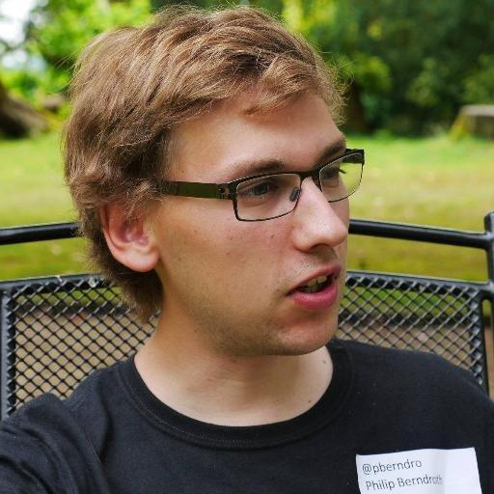
Maximilian Wilhelm
@BarbarossaTM
Philip Berndroth
@pberndro

Slide 3
pberndro
Philip Berndroth - philip@freifunk-rheinland.net
Member of the board Freifunk Rheinland e.V.
Run my own company with software and datacenter stuff
Hungarian Gulash fan
Twitter: @pberndro - Facebook: facebook.com/philip.berndroth

Slide 4
Max
Maximilian Wilhelm - max@rfc7511.org
Senior Infrastructure Architect @ University of Paderborn
SIA + Member of the board @ Freifunk Hochstift e.V.
Open Source Hacker
Fan of fine Whisky and Tiramisu
Twitter: @BarbarossaTM - Facebook: facebook.com/Maxemann

Slide 5
What is Freifunk and what does the FFRL?
Research in free wifi and mesh networks
Empower people to build free and open infrastructures
Organization of regional, national and international meetings and conferences
provide IP transit for most Freifunk communities in Germany
Access to the internet for socially disadvantaged people

Slide 6
Bring the Internet to _all_ people
A United Nations report said: disconnecting people from the internet is a human rights violation and against international law.

Slide 7
Free wifi for refugees
a government task but the Freifunk community fixed it
Communication with family and friends
Access to education and information in a foreign country
Use your money for food and family and not for prepaid internet dealers
There is no dsl/fiber in a refugee camp

Slide 8
Build internet into the wild is hard...
There is no business model -> we need donations
Bring volunteers and professionals together
many technical challenges to build wifi with mesh networks for the mass
Freifunk communities accepted the challenge
Build free internet for many thousands of people in Germany

Slide 10
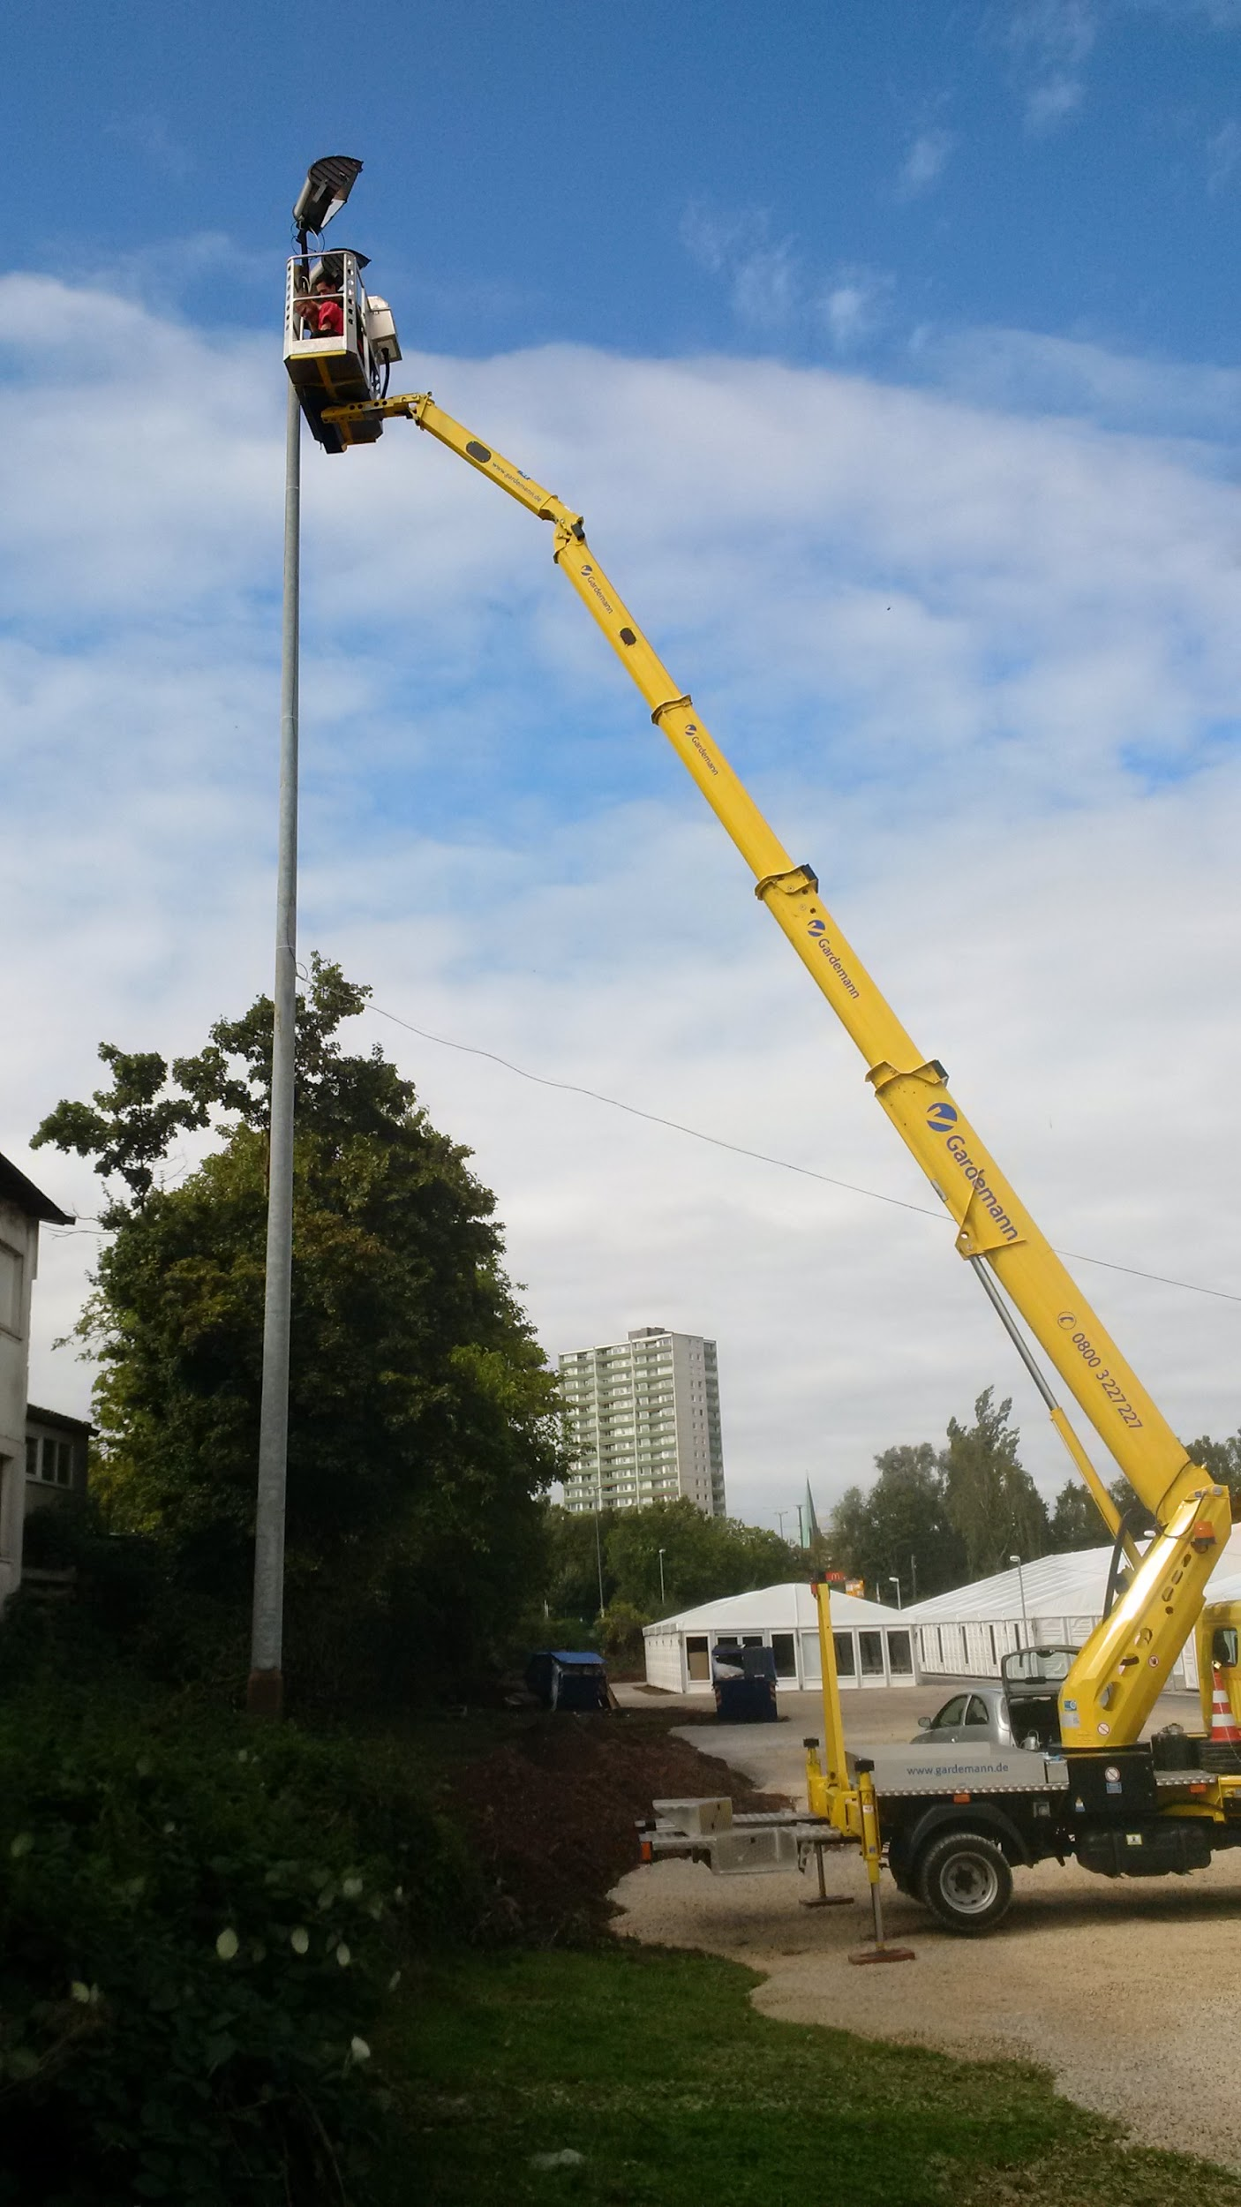

Slide 11
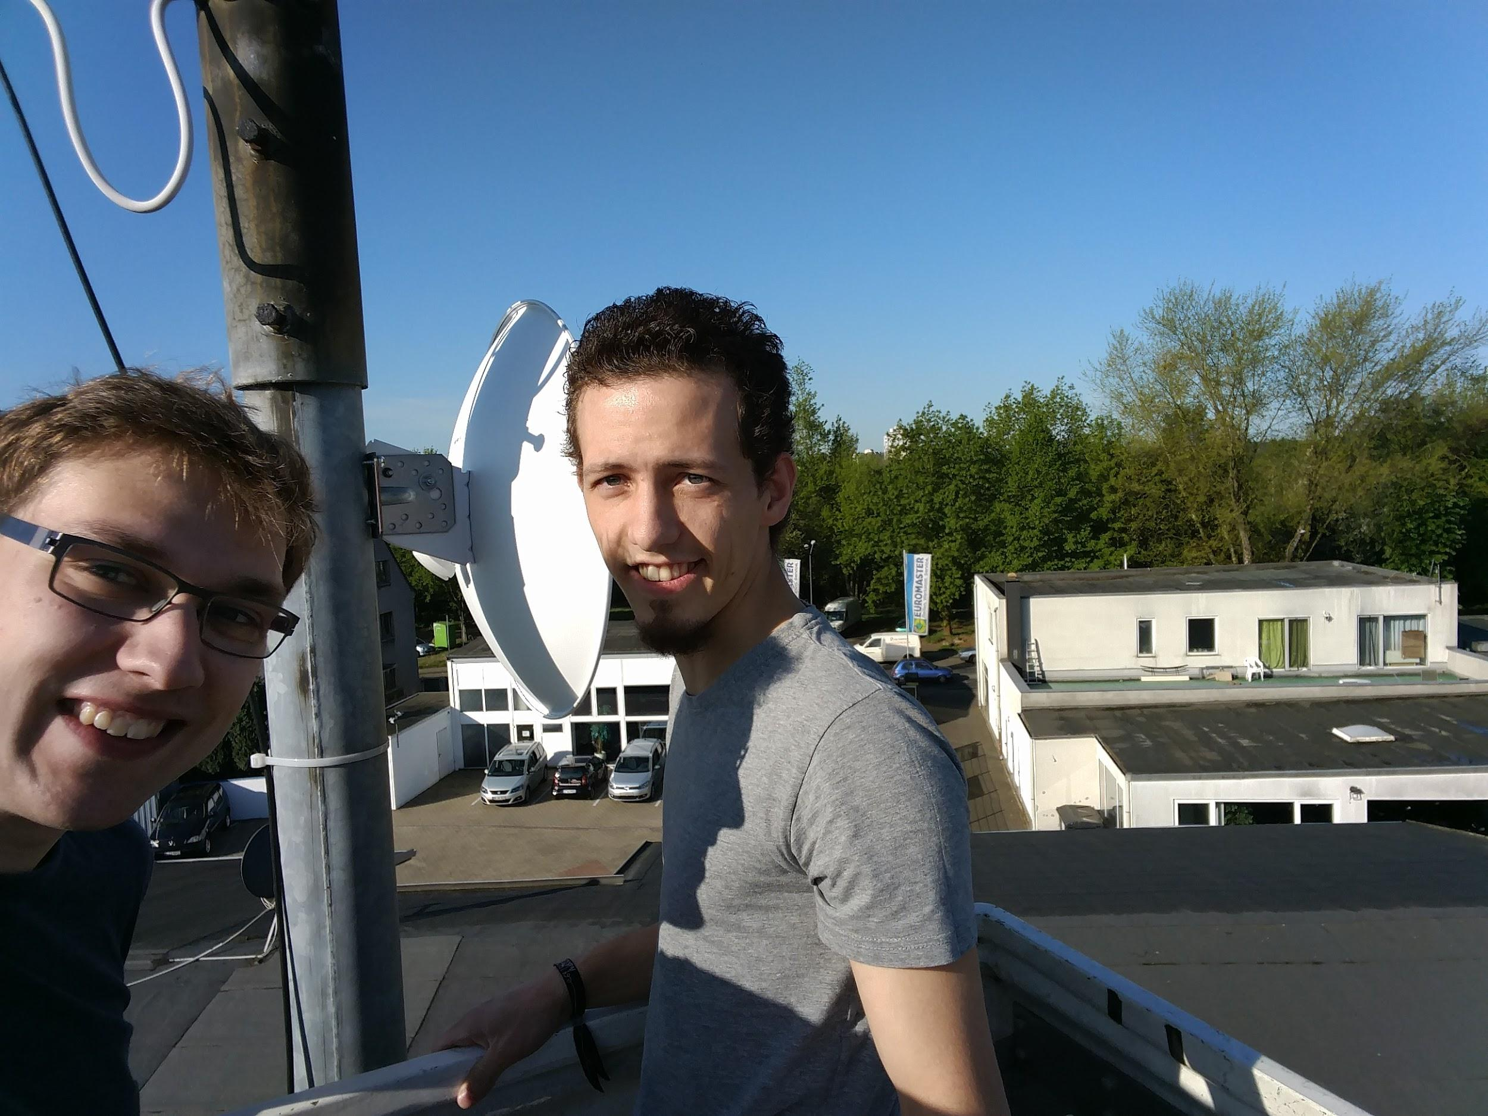

Slide 12
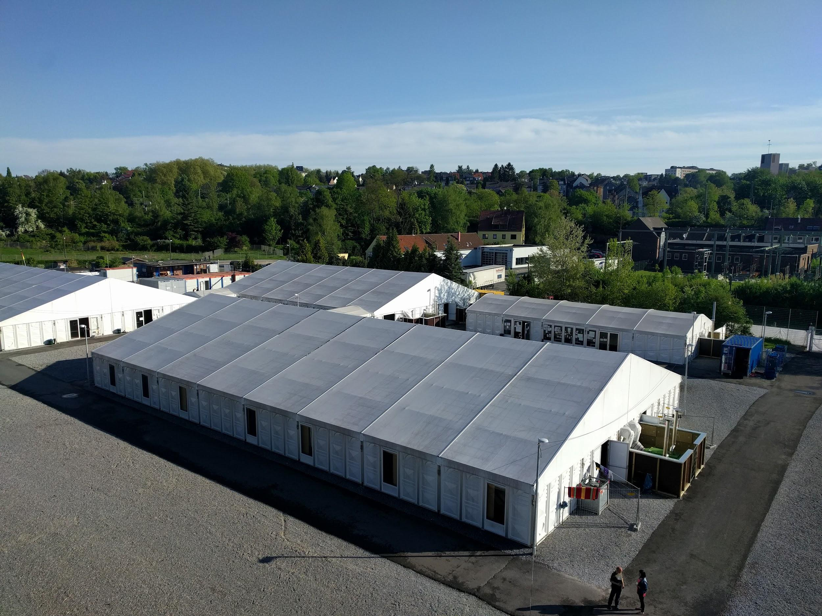

Slide 13
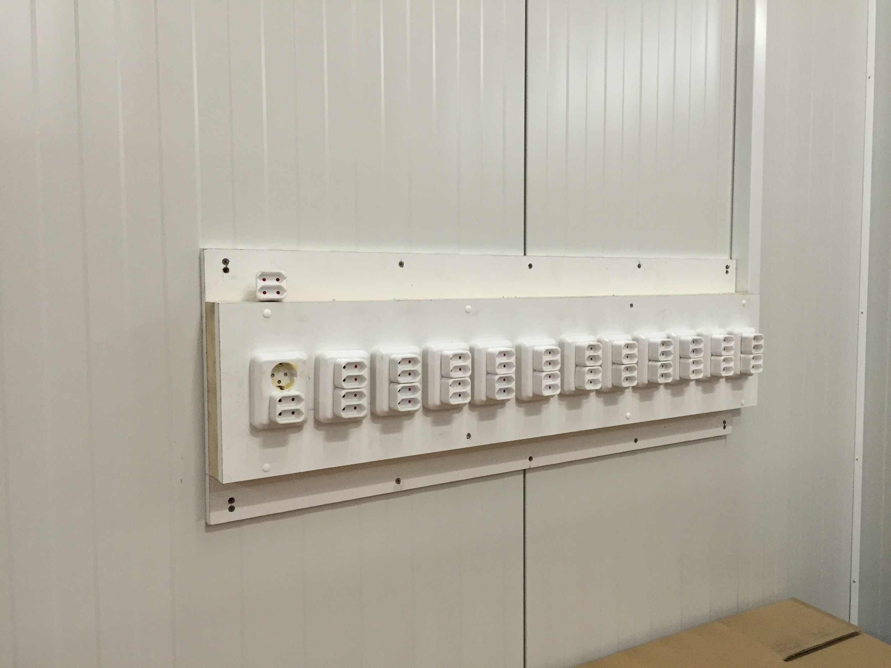

Slide 14
VPN providers don’t scale
only for a single user
mostly OpenVPN -> userspace daemon, single threaded
you have to pay per user every month
abuse is a problem, it’s not your own network
-> run your own fucking infrastructure (is hard)

Slide 15
DIY ISP
Problems:
No Budget
No Number Ressources
No Hardware
No Colo
No Transit
No Peering

Slide 16
How it began
First idea in November 2013
Freifunk Rheinland e.V. became a LIR in August 2014
First Deployments in September 2014
Notes:
Managed to collect funds for becoming LIR

Slide 17
First deployment
Weekend in September 2014:
Frankfurt (Interxion): 2x Supermicro, Xeon 5405, 4GB RAM, 4x SAS HDD RAID-1 Arch Linux, Quagga 2x 1Gbit/s Transit from a friends former employer
Berlin (Speedbone): 2x HP DL320 Gen8, Xeon E3-1220, 8GB RAM, SD Card Arch Linux, Quagga 2x 1Gbit/s Transit from IN-Berlin AS29670
Notes:
No photos form back in the day
4x RAID1, because not possible to access the POP ever again
Quagga was takt’s choice

Slide 18
Deployment #2
Düsseldorf (Interxion): 2x HP DL320 Gen8, Xeon E3-1220, 8GB RAM, SD Card Arch Linux, Quagga 2x 1Gbit/s Transit from rrbone AS39138
Notes:
A few weeks later

Slide 19
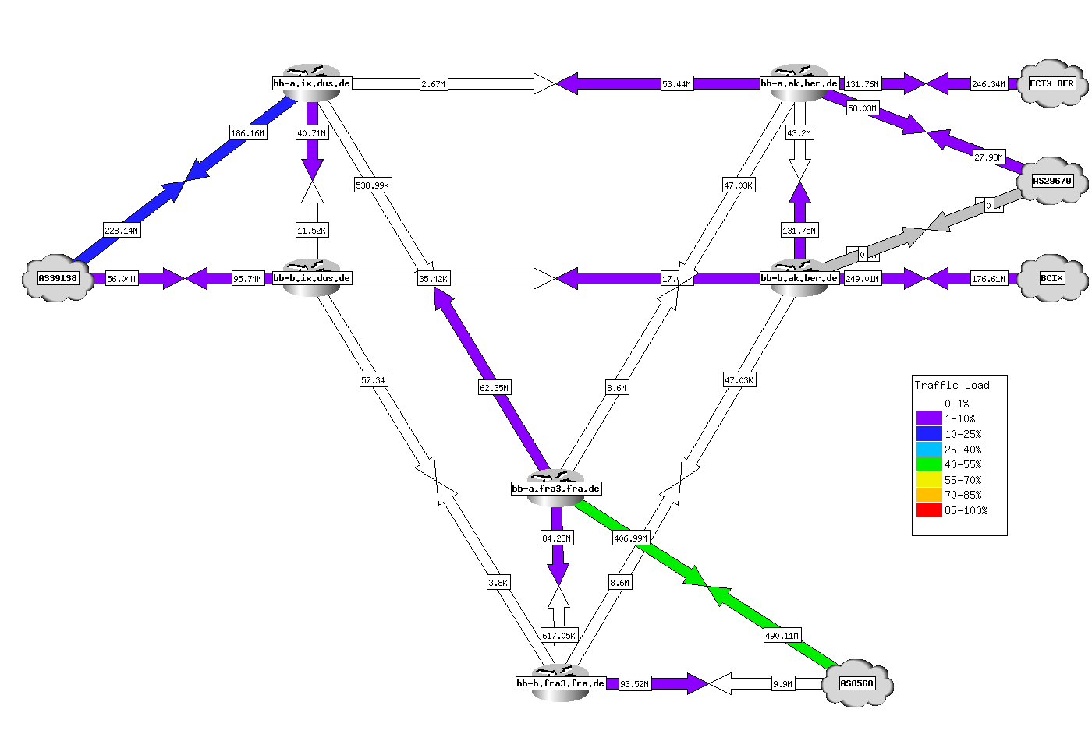
End of 2014

Slide 20
Problems in Q1/2015
Inter-POP connectivity = GRE
1G circuits are not big pipes
Transit is nice but we’d ❤ to peer
XCONs limited or impossible in some of our locations
Quagga sucks
Arch sucks (at least for our usecase)

Slide 21
Solutions (not in chronological order)
Move FRA POP to another location Move DUS POP to another location BCIX sponsored 10G port in BER ECIX sponsored 10G ports in FRA, DUS, BER, HAM (used by Freifunk Hamburg) ECIX sponsored 1G L2VPN between all Sites NLix sponsored 1G ports in FRA, DUS, BER Somehow we are on DECIX FRA (10G) Community-IX in Berlin emerged (10G) Replaced Quagga with BIRD Replaced Arch with Debian Replaced Debian Kernel with CentOS Kernel

Slide 22
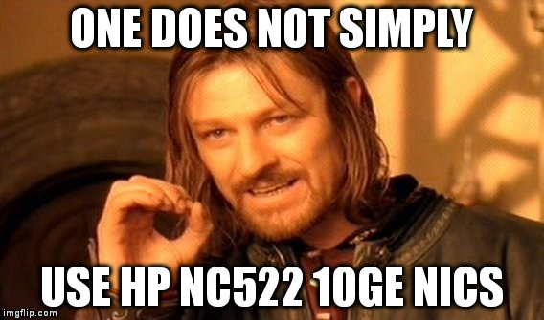
First approach to 10GE (HP NetXen)
Notes:
Port Flap on BCIX
Flapping every few seconds, we don’t know why
No Firmware Upgrade

Slide 23
Mellanox ConnectX on Kernel 4.2
for interface in `awk -F: '/eth/ {print $1}' /proc/net/dev`; do
/sbin/ethtool -K $interface tx off
/sbin/ethtool -K $interface gro off
/sbin/ethtool -K $interface gso off
/sbin/ethtool -K $interface tso off
/sbin/ethtool -K $interface sg off
done;
Notes:
Disable offloading when you forward in Software

Slide 24
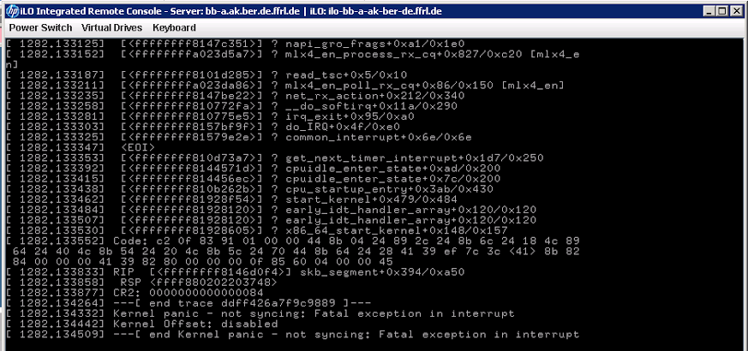
Result
Notes:
GRO offloading off, right?
Hacked Kernel to really disable offloading
Stable for half a day an crashed again -> downgrade

Slide 25
Solution: Downgrade
takt@bb-a.ix.dus.de.ffrl.de ~ % uname -a
Linux bb-a.ix.dus.de.ffrl.de 3.10.0-229.14.1.el7.x86_64 #1 SMP Tue Sep 15 15:05:51 UTC 2015 x86_64 GNU/Linux
takt@bb-a.ix.dus.de.ffrl.de ~ % cat /etc/debian_version
8.5

Slide 26
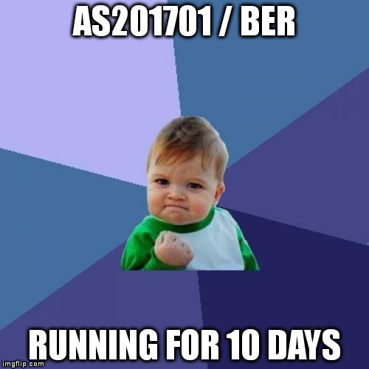

Slide 27
Quagga at work
Replaced with BIRD. No pain.
Notes:
Quagga with Full Table
Loops/Blackholes (RIB/FIB)

Slide 28
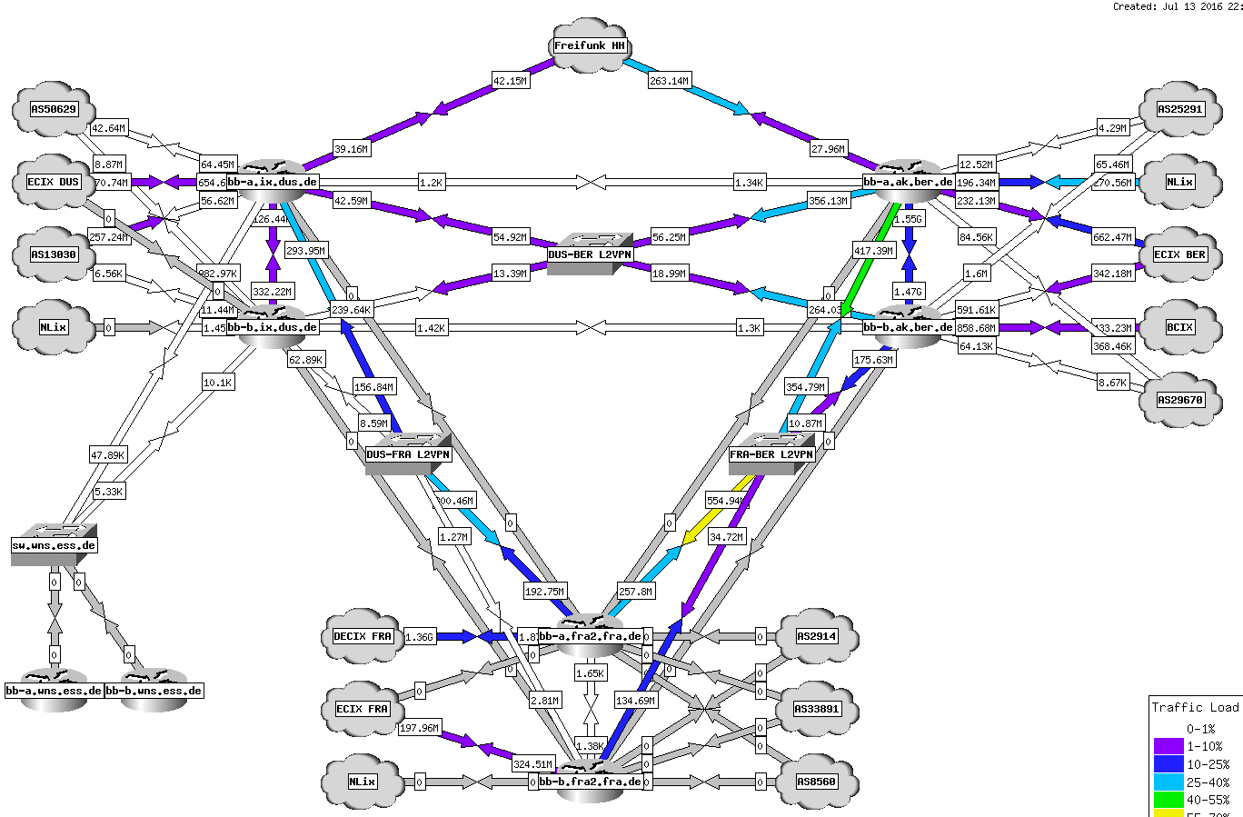

Slide 29
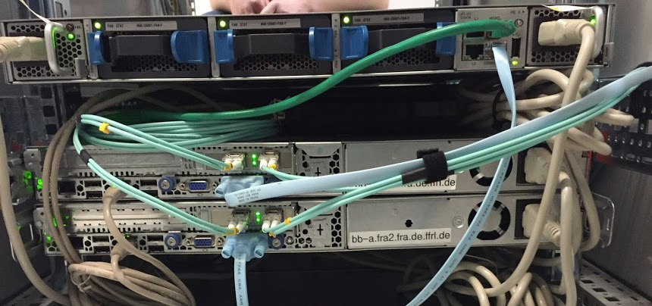
fra2.fra.de.ffrl.de

Slide 30
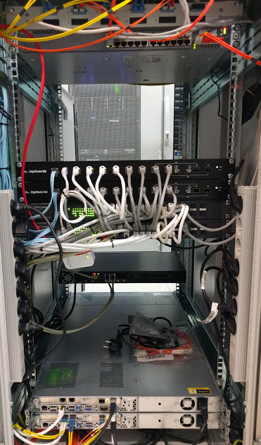
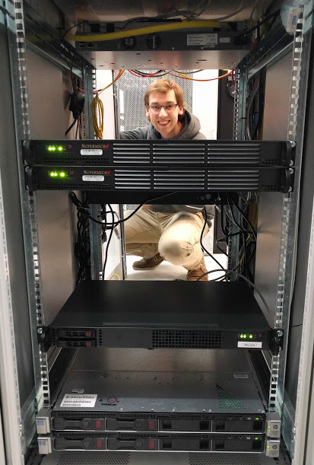
ix.dus.de.ffrl.de (and some more)

Slide 31
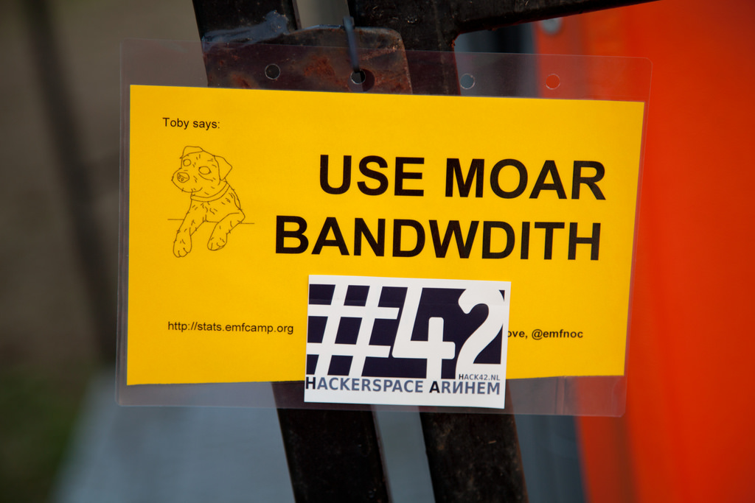
Todo since Q3/2016

Slide 32
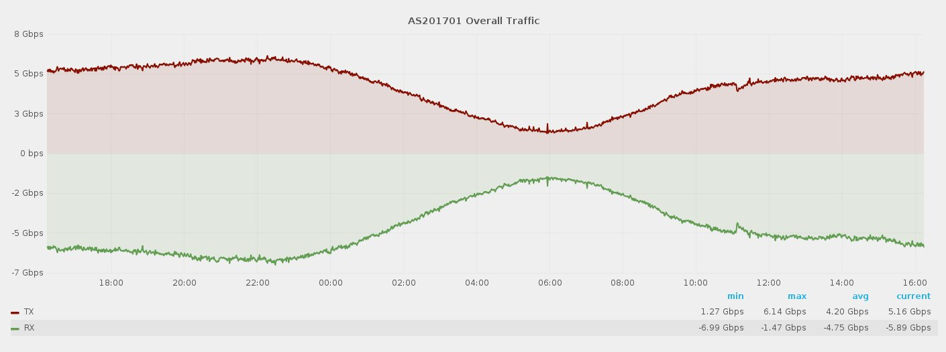
Traffic Level
06.05.2017

Slide 33
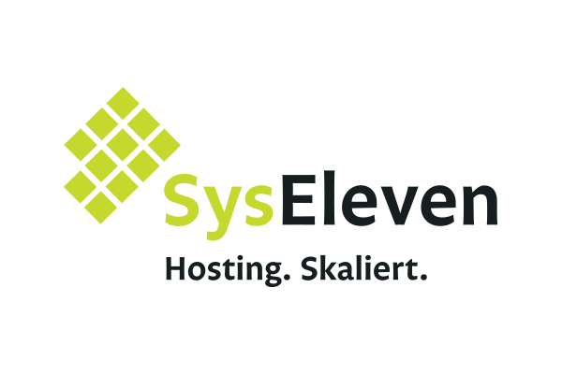
Many thanks to Sponsors and Supporters!

