Slide 1
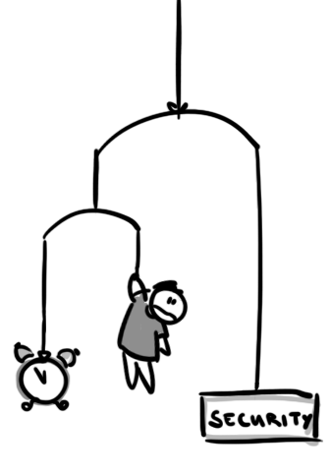
Caught between Security and Time Pressure? An Empirical Investigation of Operator's Perspective on Security Misconfigurations
CONSTANZE DIETRICH
Beuth Hochschule für Technik &
Technische Universität Berlin
[constanze.die@gmail.com]
Notes:
Well… Hi!
I’m Constanze and today I will.. basically talk about the first results of my master thesis.
For starters… Just last week there was a conference on national cyber security in Germany that brought up some interesting numbers… According to the Federal Criminal Police Office, one out of three German companies is at the recieving end of cyber crimes and the damage caused to the economy is estimated at 50 billion Euro per year and it’s only supposed to get worse in the future.
The reason for me starting with this lame attempt to get your attention is… We see misconfigurations as a main cause for security incidents. Therefore we investigate HOW Misconfigurations happen - on a rather personal level.

Slide 2
Outline
2
1 Security Misconfigurations
2 Empirical Approach
3 Preliminary Findings
4 Conclusion
Notes:
In this talk I will first address a few examples for Security Misconfigurations, then explain our empirical approach…
And as you can guess by the rest of the outline we’re at an early stage with our research. Nevertheless the first glimpse into the topic turned out to be giving some surprising insights already.
So without further ado...

Slide 3
Security Misconfigurations
3
Simple errors in deploying an internet service that lead to security issues:
Publication of secrets/passwords
Missing/disabled authentication
...
Notes:
Security Misconfigurations are basically quite simple errors in deploying an internet service that lead to security issues. To name a few we started thinking of misconfigurations as - for example - the accidental publication of passwords which got pushed online with a bunch of other files or are basically clearly visible because someone forgot to encrypt a login page.. There’s disabled or missing authentication that might allow everyone to login as anyone which never gets noticed because - well, it works for ME. There is quite a variety, but for now, with a few ideas in mind, let’s briefly look into some examples of security incidents...

Slide 4
Examples
4
Running your MongoDB on the Internet
Notes:
Running your MongoDB on the internet! Gives a whole new perspective on distributed backups… To revive your memory… In early 2015 40.000 MongoDB instances were found on the internet. Unprotected. (Data ready to be retrieved, exploited, altered and hijacked.
And as an example… GeekedIn, a kind of job service platform that “gets you the best developers matching your needs.” scraped Github and aggregated names, email addresses, locations and - of course - github profiles in a 65-GB database. 8 million individual data sets in plain text. Without password. And while sure, you can get all that information also by just looking at each profile - to see that pile of data outside of GitHub, probably passed through data breach trading circles - feels just wrong…

Slide 5
Examples
4
Running your MongoDB on the Internet
Having your TR-069 publicly reachable
Notes:
Second one. Having your TR-069 publicly reachable: And thousands of customers Online. Late 2016 the telecommunications company Telekom left a remote maintanance interface unattended. Hence, 900.000 routers had to face a romote code execution attack. Indeed, they were quite lucky under these circumstances because the routers didn’t have the operating system the attacker expected. What happened, though, is that there was a DoS-vulnerability - not causing 900.000 routers to get infected. But to crash.

Slide 6
Examples
4
Running your MongoDB on the Internet
Having your TR-069 publicly reachable
Storing your AES key next to your encrypted backups
Notes:
The last fail I want to mention: The german service Mitfahrgelegenheit was kind of a car sharing service for private persons. Although they had already withdrawn their service earlier that year, they kept an archive with user data including bank accounts. It was AES-encrypted. But what took all the riddling fun away was the key, that was stored right next to the backup in the same cloud. You know - in case it gets lost.
So exploring a variety of incidents... A few questions come up, don’t they?

Slide 7
Who, what, why?
5
Who misconfigures?
What gets misconfigured (easily)?
Why does it get misconfigured?
Notes:
We assume the operators had something to do with these incidents right? But still… who are they? Storage admins misconfiguring a firewall? A database admin misconfiguring an iSCSI switch?Programmers with root?
Also: What gets misconfigured - easily - or often.
And finally: Why does it happen? - Simply overworked? - Caught in constant pressure to deliver? - Missing a KPI for just doing things right?
We didn’t know and we still don’t know all of it. But we want to. And if you’ve been asking yourselves what to do with that information: In the end it’s all about...

Slide 8
Who, what, why?
5
Who misconfigures?
What gets misconfigured (easily)?
Why does it get misconfigured? How to prevent misconfigurations?
Notes:
How to prevent misconfigurations? Are there Measures… Best Practices… Design Patterns… Anything that allows for less security issues.
And who else would be more suitable to ask than the operators?

Slide 9
Asking Operators
6
Research on Security & Usability mainly focusses on end-users
Asking people is hard
Asking the right questions is even harder Think: “Please buy a bottle of milk; if they have eggs, bring a dozen.”
Notes:
But there are a few things to keep in mind...
First: There’s not a lot to build on. While configuration undoubtedly IS a matter of usability and misconfigurations may be the result of a really bad one, usablity and security research mainly focusses on end users. How to make them choose a better password? How to make them care for email encryption… But the operators…? Well, they’re experts. And expert systems don’t have to be usable, right?
Then building on the little we have… Asking people is quite difficult in general - Especially if you ask them about mistakes they might have made... And asking operations people is even harder... Not only because I am not an operator myself and my vocabulary might lack a few terms... But somehow they tend to be busy operating things. Also a few of them seem to have had some unwanted experiences with undemanded “solutions” to their problems - so the promise of trying to make their work easier isn’t necessarily a selling point
Finally, as always, you have to know what you want to know. And as soon as you do you have to design your questionnaires accordingly and unmistakeably.
But despite all these difficulties..: We give it a try…

Slide 10
The Usual Approach
7
1 Explore the issue
2 Do small focus groups with target audience
3 Do structured interviews with target audience
4 Build a questionnaire to get quantitative insights
Notes:
And this slide is actually just in here because you know,working in science you gotta show some method here… But it didn’t take long for us to realize that operators require adapted procedures...

Slide 11
The Sysadmin Approach
8
Go to the local sysadmin regulars’ table and talk to them
Notes:
We went to the local sysadmin regulars table and talked to them while trying to stay sober, for once. They appeared open and talkative having recreational beer and schnitzel, but we would soon see that for most of them it takes several email-reminders to recruit them for a focus group. (Although, I want to mention the one out of 76 mailinglist subscribers that replied right away. Thank you. You’re awesome.)
The next step was...

Slide 12
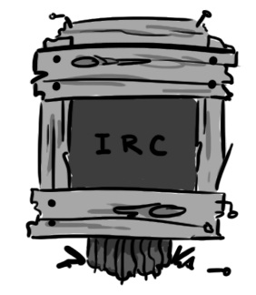
The Sysadmin Approach
8
Go to the local sysadmin regulars’ table and talk to them
Install an IRC client
Notes:
Travelling back to - as my advisor said - the good times of the Internet and search the IRC for operators looking for a break:
And thanks to the #denog-Channel (thumbs up) that worked out and gave us a decent base to work with.

Slide 13
The Sysadmin Approach
8
Go to the local sysadmin regulars’ table and talk to them
Install an IRC client
5 Interviews and 1 focus group with 5 participants...
Did you ever encounter security misconfigurations?
What do you think: Why do they occur?
Did a security misconfiguration incident change anything about this?
Notes:
So via IRC we were able to conduct five interviews and after whining and screaming and rescheduling like thirty times we could even get five volunteers to participate in an IRC focusgroup
And since we couldn’t provide them with snacks or drinks which we would usually do, they were basically reimbursed with the chance to rant as much as they liked during the sessions.
And these evolved around three questions: Did you ever encounter security misconfigurations? Which also includes mistakes made by other operators. Why did they occur? And Did a security misconfiguration incident change anything about this?

Slide 14
Notes:
And there we go, all sorted out.
So. The interviews were conducted as anonymously as IRC goes. I told them who I was and they were assured I wouldn’t tell who they were.
And you may notice that the answered questions aren’t exactly the ones I initially asked. That’s purpose.
So let’s talk about: What happened?

Slide 15
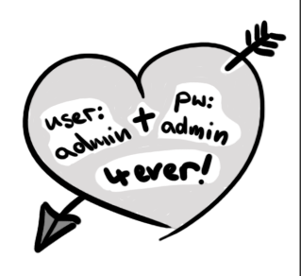
What happened?
9
Beloved Defaults
Notes:
First: Some things just never change… A few of these I mentioned earlier… like by default disabled authentication… But the main and ever-present issue here is login data. Whether it’s the manufacturer’s default password that can be googled in three seconds or the “We’re just testing. For now, let’s go with the usual admin/admin-combo.” I think you can guess, what ends up being used in production... The next category we identified is...

Slide 16
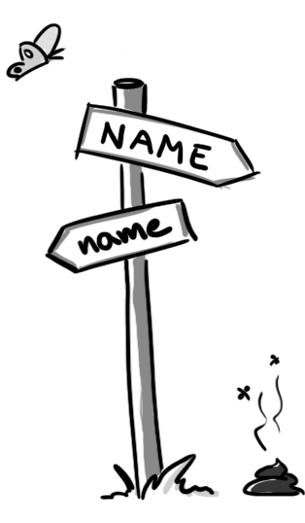
What happened?
9
Beloved Defaults
Misleading Conventions
Notes:
Conventions
To assume that allcaps in shell scripts imply environment variables is kind of obvious - but still just a convention, not a law. And if you’ve only seen strictly, spatially devided systems each handling internal OR external services exclusively, elsewhere you might open unsuspected doors - by just doing what you’re used to do.
The third class is accidents...

Slide 17
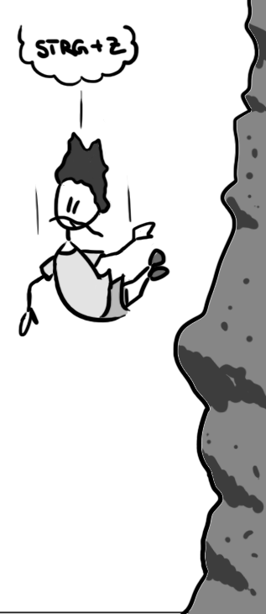
What happened?
9
Beloved Defaults
Misleading Conventions
Troublesome Accidents
Notes:
Versehen This contains all those misconfigurations that happen just because the operator - for any reason - wasn’t careful enough. That might be as simple as a typo, working in ten different windows and picking the wrong one for configuration or also accidentally deploying debug configurations that lack some essential filters...
And lastly… The Lost, Forgotten and Abandoned

Slide 18
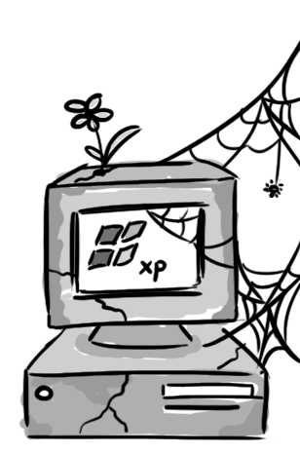
What happened?
9
Beloved Defaults
Misleading Conventions
Troublesome Accidents
The Lost, Forgotten and Abandoned
Notes:
The Lost, Forgotten and Abandoned
This includes all the issues that emerge because someone didn’t take enough care of a system. Like disregarded security patches or the forgotten print server that hides behind cleaning supplies in that room at the other end of the floor. But it also contains the - as we call them - “#notmydepartment”- issues that sprout, where there is a responsibility gap between at least two parties.
Now… Knowing what the issues are, what’s their origin?

Slide 19
Why did it happen?
10
Lack of Experience
Notes:
The first reason is a lack of experience. And this is what we’ve been told exactly like that by pretty much every participant. Newly fledged graduates, still wet behind their ears, might use online ressources that make them tear down a firewall without realizing it. They might also find comfort in keeping default credentials for whenever they need remote support by the manufacturer. Even just new employees that aren’t familiar with the existing system yet, may cause simple errors - especially if there is no decent documentation to be found. (Taking familiarized operators... When they get assigned to new domains, they might be taking a lot more care of their old babies while disregarding the new ones.) Often mentioned was also this one programmer… Or was he the web designer? Anyway. He has been seen with a Linux screen. He MUST be eligible for the job...
So through all levels of experience there is some kind of lack to be found. Interestingly, though, all of the participants could confirm that the first-hand-experience of a security incident made them more sensitive to security in general. However, there will be a little disclaimer later on.

Slide 20
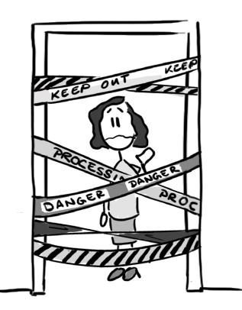
Why did it happen?
10
Lack of Experience
Non-existing / unspecified / too strict / too loose / too complicated Processes
Notes:
The next reason is processes. And this is where the responsibility starts slowly drifting towards the management.. (Most of these issues are common difficulties when designing processes.)
If there are no specifications at all or only very loose ones, basically everyone does what they feel like doing which leads to quotes like: “The operator password is written in the active directory and has been there years! We cannot change it! Who knows which software stops working because it got hardcoded somewhere?”
And that already indicates another issue which is insufficient communication. Without announcement random features get deployed. And guess what. They’ve never been firmly tested, because there’s no process for that.
But also the other way round. If processes are too strict, operators tend to just check off their todo-lists without thinking outside auf these checkboxes - which may lead to #notmydepartment-issues.. (And apparently this problem grows depending on the size department…)
The next explanation is...

Slide 21
Why did it happen?
10
Lack of Experience
Non-existing / unspecified / too strict / too loose / too complicated Processes
Betrayed Faith in Suppliers
Notes:
Betrayed faith in suppliers. If the manufacturer says… “Won’t break. Ever.”, especially the management is tempted to believe them - because it’s less work than building backstops for something that’s supposed to never break.
This also includes certificates. It sounds good if something is certified, right? But often no one actually checks WHAT was certified or for which system… So it just lies around, never getting updated...
The next one is rather rare but still worth mentioning...

Slide 22
Why did it happen?
10
Lack of Experience
Non-existing / unspecified / too strict / too loose / too complicated Processes
Betrayed Faith in Suppliers
Backfiring Legacy Support
Notes:
Backfiring Legacy Support. Yes, philantropy is nice sometimes. But using outdated encryption just because we don’t want to exclude people with really old, incapable android smartphones may also open doors for some rather bad guests.
And if you’re missing an explanation now, do not worry… It’s probably part of the last category...

Slide 23
Why did it happen?
10
Lack of Experience
Non-existing / unspecified / too strict / too loose / too complicated Processes
Betrayed Faith in Suppliers
Backfiring Legacy Support
Unwise Budgeting
Notes:
Unwise budgeting. So the principal wants abstract security but actually doesn’t budget any ressources. “You’re the operators. Just make it secure. But finish until tomorrow evening, please.” So often there is just no time for tests, reviews or documentation. The operators are basically compelled to build makeshift arrangements and hope they’re gone before it explodes. And to seize the issue of accidents. They have a disposition to happen when people are overworked.
Furthermore there is this: “Well, the software we use only runs on Windows XP. Do you even have an idea how much it would cost to upgrade? It works, doesn’t it?”
Well And Supposing there WAS a purchase of new technology, we hear... “Well, this is new and shiny, but the usage can’t be so different, right? So, if there’s any issue, just google it…” And there goes the advanced training.
And to be blunt here… I don’t want to display operators as only reserved and obedient people. They themselves sometimes prefer to work on new, cool features, as well or actually do voice to the managemant. It’s rather, that a lot of them have superiors that just do not understand what the operators remark, contentwise. Even worse it gets if they’re only hiring external consultants… “QA? Automation? Bullshit! We don’t need this!” I guess, you can see the point here.
Now on how to prevent this...

Slide 24
How to prevent this?
11
Provide for Experience
Voice to management in case of deficient Processes
Challenge Faith in Suppliers (Make them listen to you, OPS!)
Ditch Legacy Support
Budget wisely
Notes:
Yes, a lot of decent solutions maybe aren’t in your personal scope, BUT there are a few things you can also do yourselves, if you’re an operator.
If you are a senior, get yourself a freshman and provide for experience. Pelt them with your own best practices, show them disastrous Postmortems and let THEM write the documentation. It’s also a convenient way to check whether they got it.
If processes are broken or the holy faith in manufactures appears dubious to you, don’t just hide behind “Not my department”, but talk to the management. Bang on the table if necessary. Or if you want to give it your all, get YOURSELVES a management position, if you haven’t already -- because, experienced operators in management appear to make a lot of sense - finally someone having time scheduled for documentation, quality assurance, testing, scanning, automation…
And also for misconfigurations. Because they happen. But if you’ve already scheduled time for building double bottoms or incident troubleshooting, it won’t hurt as much.

Slide 25
Conclusion
12
Misconfigurations happen.
Knowing how allows for detecting measures to prevent security incidents.
We’re not ready…
Questionnaire coming soon to an operations mailing list near you!
Notes:
So what’s our conclusion so far? As I said, misconfigurations happen. And sometimes that might even be a good thing, because… It makes operators more sensitive to Security. And not only them. Often all these nice ideas regarding smarter processes and more generous budgeting are already there, but don’t get implemented until it did actually hurt.
[Here is the disclaimer I promised earlier, though: In these interviews and the focusgroup, I only talked to seriously interested and zealous operators, that are aware of what they know and what they do. Probably guys like you. So, as yet, we don’t know how operators work that have been sitting on their job for 30 years and meanwhile stopped trying to stay up to date or those that settled for being the admin without actually having a thing for the job. But getting those guys to talk is probably a bigger task, so rather material for another study…]
Even without them:) We’re not ready, yet. So if you happen to know someone that is an operator, please feel free to share your experiences with us. And also make sure to fill out that upcoming questionnaire. It is supposed to be released in about four to six weeks and your input is much-needed.
We could get some very vivid insights and we think that with further and quantitative research we’ll at least be able to provide a scientifically acquired plea to all the decision makers out there… But to be honest, it would be nice to have an actual solution...

Slide 26
Conclusion
12
Misconfigurations happen.
Knowing how allows for detecting measures to prevent security incidents.
We’re not ready…
Questionnaire coming soon to an operations mailing list near you!
Notes:
Our question to you here is: How may we help you?

Slide 27
Conclusion
12
Misconfigurations happen.
Knowing how allows for detecting measures to prevent security incidents.
We’re not ready…
Questionnaire coming soon to an operations mailing list near you!
Notes:
Two more things… If you have further questions or feedback, PLEASE come find me during the meeting or ask me for a “business card”…
And also: Thanks to the RACI committee for giving me the chance to present our research here. We really appreciate this.

