Slide 1
Entropy/IP: Uncovering Structure in IPv6 Addresses
RIPE 74 - Budapest, 8-12 May 2017
Paweł Foremski, David Plonka, Arthur Berger

Slide 2
What’s Entropy/IP?
A system that automatically learns the syntax of Internet addresses known to be active
Combines Entropy, Machine Learning, and Probabilistic Graphical Models
Goal: insight into addressing plans of IPv6 networks
Application: IPv6 scanning vulnerability

Slide 3
Background: IPv6 brings freedom
128 bits: a quantity that makes a new quality
IPv6 made the Internet addressing space sparse
No Single Algorithm for addressing:
[network ID (64 bits)] + [interface ID (64 bits)]
[network ID]: routing prefix / static / other
[interface ID]: SLAAC / static / other
IPv6 networks adopt their own addressing schemes
Notes:
Comparing with IPv4: no more need to densely pack subnets with hosts
Talk will support these claims

Slide 4
Entropy/IP: overview
Input:
IP Addresses
1. Entropy Analysis
2. Address Segmentation
3. Segment Mining
4. Bayesian Modeling
Output:
Statistical Model
Notes:
“Initial attempt” / “reasonable way” to find structure / not the only way
More can be done in this area (in the paper)

Slide 5
Entropy Analysis: input
2001:0db8:0010:0013:0000:0000:0000:07fe
2001:0db8:0010:0000:0000:0000:0000:0ed3
2001:0db8:0010:0003:0000:0000:0000:0fb5
2001:0db8:0020:d05f:882f:6082:f768:710d
2001:0db8:0010:0004:0000:0000:0000:04dc
2001:0db8:0010:0003:0000:0000:0000:03ce
2001:0db8:0010:0008:0000:0000:0000:0794
2001:0db8:0010:000a:0000:0000:0000:0923
2001:0db8:0010:0006:0000:0000:0000:003c
2001:0db8:0022:1014:aef6:60af:d029:63cd
2001:0db8:0010:0012:0000:0000:0000:0c7b
2001:0db8:0022:10c0:5100:ac7d:96f5:5851
2001:0db8:0010:0002:0000:0000:0000:0de8
2001:0db8:0010:0008:0000:0000:0000:0506
2001:0db8:0022:2053:4e6a:a11a:d57f:e26d
(...)
Notes:
What’s the input, where it comes from? (“by standard means”, examples)
Not necessarily “random” (it just might appear so) – we’re leveraging sparsity

Slide 6
Entropy Analysis: operation
2001:0db8:0010:0013:0000:0000:0000:07fe
2001:0db8:0010:0000:0000:0000:0000:0ed3
2001:0db8:0010:0003:0000:0000:0000:0fb5
2001:0db8:0020:d05f:882f:6082:f768:710d
2001:0db8:0010:0004:0000:0000:0000:04dc
2001:0db8:0010:0003:0000:0000:0000:03ce
2001:0db8:0010:0008:0000:0000:0000:0794
2001:0db8:0010:000a:0000:0000:0000:0923
2001:0db8:0010:0006:0000:0000:0000:003c
2001:0db8:0022:1014:aef6:60af:d029:63cd
2001:0db8:0010:0012:0000:0000:0000:0c7b
2001:0db8:0022:10c0:5100:ac7d:96f5:5851
2001:0db8:0010:0002:0000:0000:0000:0de8
2001:0db8:0010:0008:0000:0000:0000:0506
2001:0db8:0022:2053:4e6a:a11a:d57f:e26d
(...)
Entropy:
H( X₁₆ ) = 3.8
H( X₁₈ ) = 2.2
/4
/4
Notes:
Interpretation of entropy (uniform distribution)
Wcan be the maximum value? (think of normalized entropy)
Different bit widths possible

Slide 7
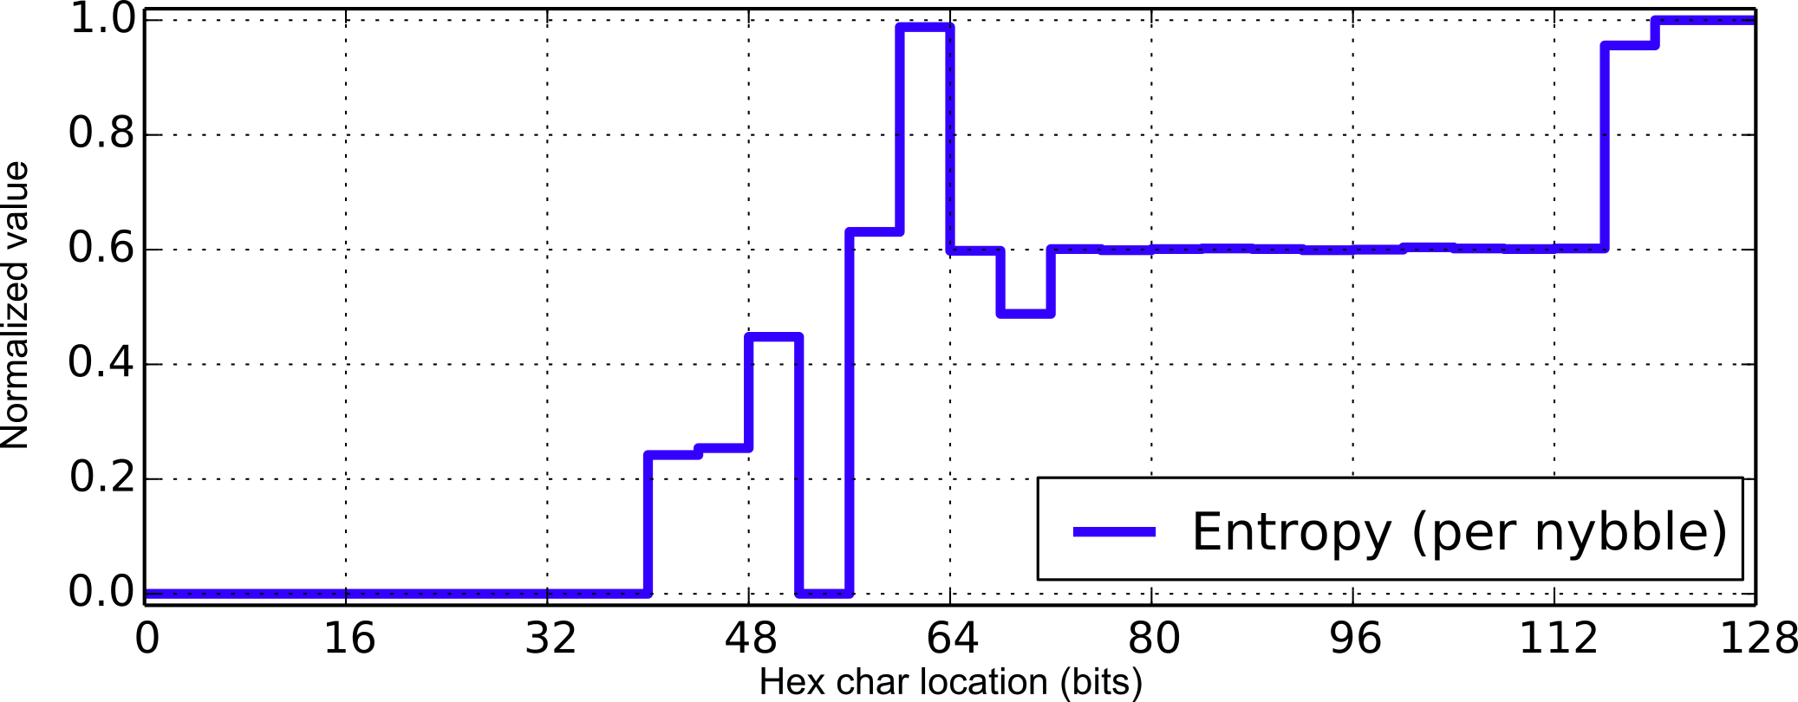
Entropy Analysis: hex character variability

Slide 8
Address Segmentation: group by similar entropy
Notes:
“This is what works well”, but definitely more to do here
Adjacent nybbles with similar entropy the natural grouping. Other heuristics can definitely be found.

Slide 9
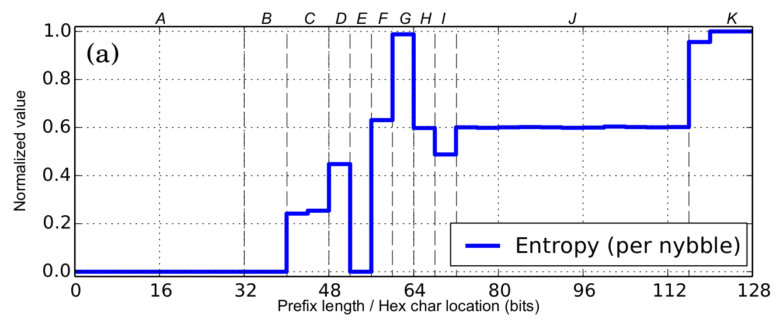
Address Segmentation: list of bit ranges
Smallest RIR prefix
Network ID vs. interface ID

Slide 10
Segment Mining: what’s inside?
Extract all values from given segment, and find:
Most popular values
e.g. constants, enumerations, etc.
Densely packed ranges of values
e.g. adjacent subnets
Uniform distributions
e.g. counters, randoms
Summarize what’s left
Notes:
Comment more on DBSCAN? (state of the art)

Slide 11
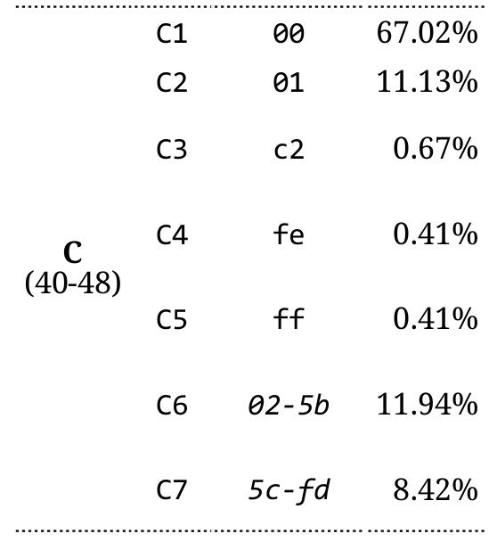
Segment Mining: output & encoding
Code Value Frequency
2001:0db8:0841:2500:0000:d9a0:5345:0012
2001:0db8:0841:2500:0000:d9a0:5345:0012
(A1, B2, C6, D4, E5, F1, G12, H1, I2, J3)
Notes:
Explain notation A1, C3, etc. (random variable C takes 7 discrete values)

Slide 12
Bayesian Network: segment inter-dependencies
2001:0db8:0010:0004:0000:0000:0000:03cc
2001:0db8:0010:0003:0000:0000:0000:0f97
2001:0db8:0022:1028:9e83:1334:17c0:897a
2001:0db8:0022:3064:69f5:02d2:f223:8635
2001:0db8:0010:0014:0000:0000:0000:0347
2001:0db8:0010:0014:0000:0000:0000:022a
2001:0db8:0010:0005:0000:0000:0000:03ca
2001:0db8:0010:0015:0000:0000:0000:0ae9
2001:0db8:0021:0056:8032:6eb3:6098:3084
2001:0db8:0010:0003:0000:0000:0000:018b
2001:0db8:0010:0002:0000:0000:0000:0424
2001:0db8:0010:0013:0000:0000:0000:0e2f
2001:0db8:0022:20a4:3eb9:5fca:3ccb:2aae
2001:0db8:0021:0014:3326:6434:74c9:aad6
2001:0db8:0010:000f:0000:0000:0000:07bd
(...)
( A1, B1, C1, D1, E1, F1, G3, H1, I11 )
( A1, B1, C1, D1, E1, F1, G1, H1, I11 )
( A1, B1, C2, D2, E1, F5, G4, H2, I11 )
( A1, B1, C2, D3, E1, F3, G3, H2, I11 )
( A1, B1, C1, D1, E1, F2, G3, H1, I11 )
( A1, B1, C1, D1, E1, F2, G3, H1, I11 )
( A1, B1, C1, D1, E1, F1, G2, H1, I11 )
( A1, B1, C1, D1, E1, F2, G2, H1, I11 )
( A1, B1, C3, D1, E1, F4, G8, H2, I11 )
( A1, B1, C1, D1, E1, F1, G1, H1, I11 )
( A1, B1, C1, D1, E1, F1, G8, H1, I11 )
( A1, B1, C1, D1, E1, F2, G1, H1, I11 )
( A1, B1, C2, D4, E1, F6, G3, H2, I11 )
( A1, B1, C3, D1, E1, F2, G3, H2, I11 )
( A1, B1, C1, D1, E1, F1, G8, H1, I11 )

Slide 13
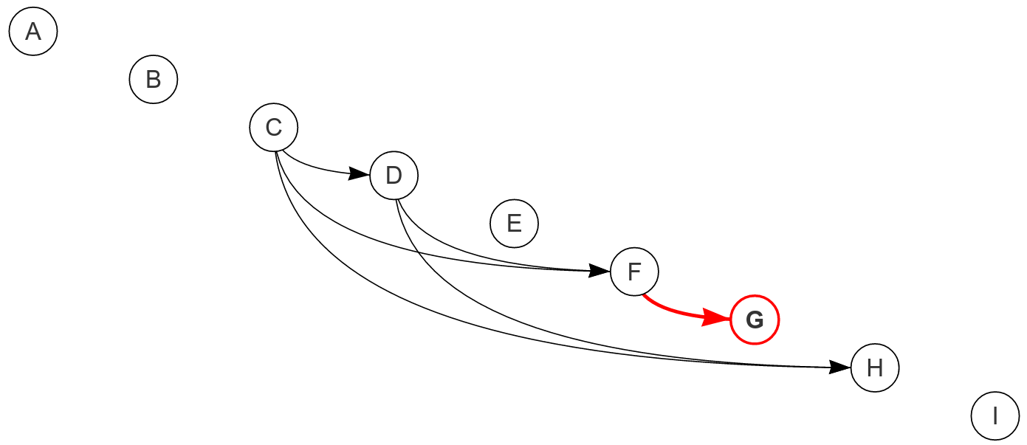
Bayesian Network: BNfinder
( A1, B1, C1, D1, E1, F1, G3, H1, I11 )
( A1, B1, C1, D1, E1, F1, G1, H1, I11 )
( A1, B1, C2, D2, E1, F5, G4, H2, I11 )
( A1, B1, C2, D3, E1, F3, G3, H2, I11 )
( A1, B1, C1, D1, E1, F2, G3, H1, I11 )
( A1, B1, C1, D1, E1, F2, G3, H1, I11 )
( A1, B1, C1, D1, E1, F1, G2, H1, I11 )
( A1, B1, C1, D1, E1, F2, G2, H1, I11 )
( A1, B1, C3, D1, E1, F4, G8, H2, I11 )
( A1, B1, C1, D1, E1, F1, G1, H1, I11 )
( A1, B1, C1, D1, E1, F1, G8, H1, I11 )
( A1, B1, C1, D1, E1, F2, G1, H1, I11 )
( A1, B1, C2, D4, E1, F6, G3, H2, I11 )
( A1, B1, C3, D1, E1, F2, G3, H2, I11 )
( A1, B1, C1, D1, E1, F1, G8, H1, I11 )
 | G:
F: | G1 | G2 | G3
F1 | 13% | 10% | 10%
F2 | 18% | 20% | 20%
F3 | 13% | 7% | 9%
F4 | 16% | 9% | 10%

Slide 14
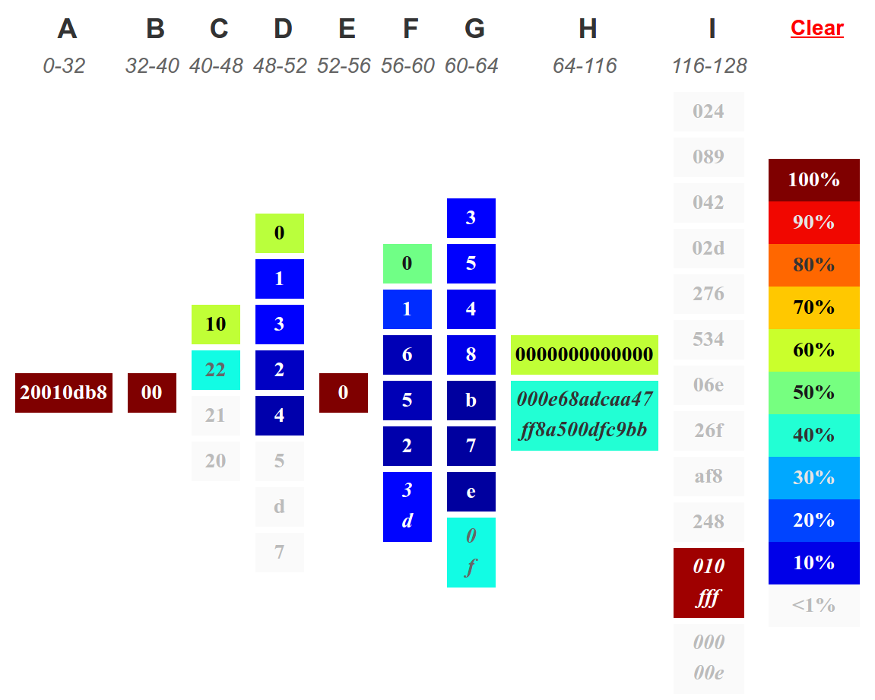
Bayesian Network: visualization
Notes:
“Large range of values” in H
UI is in a web browser

Slide 15
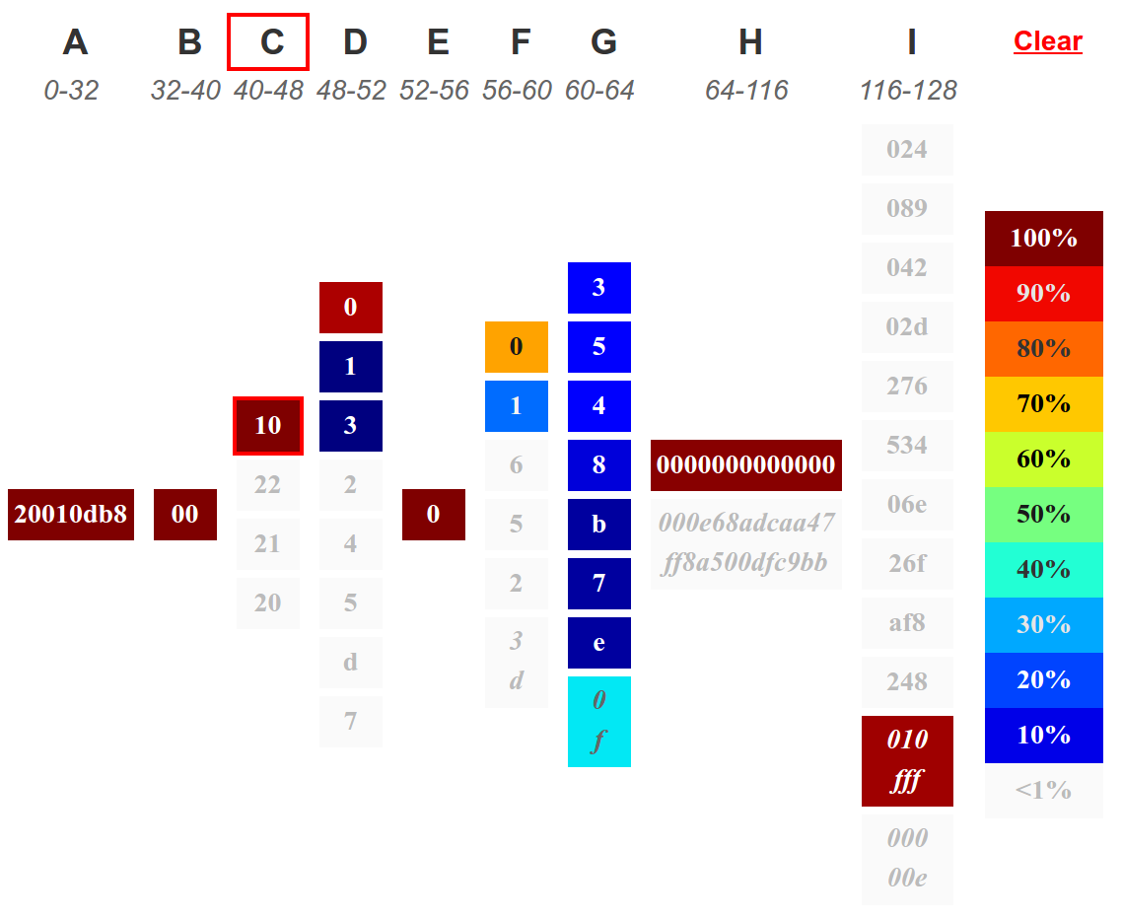
Bayesian Network: visualization (2)
condition on C1
Notes:
Mention “available right now” / URL at end

Slide 16
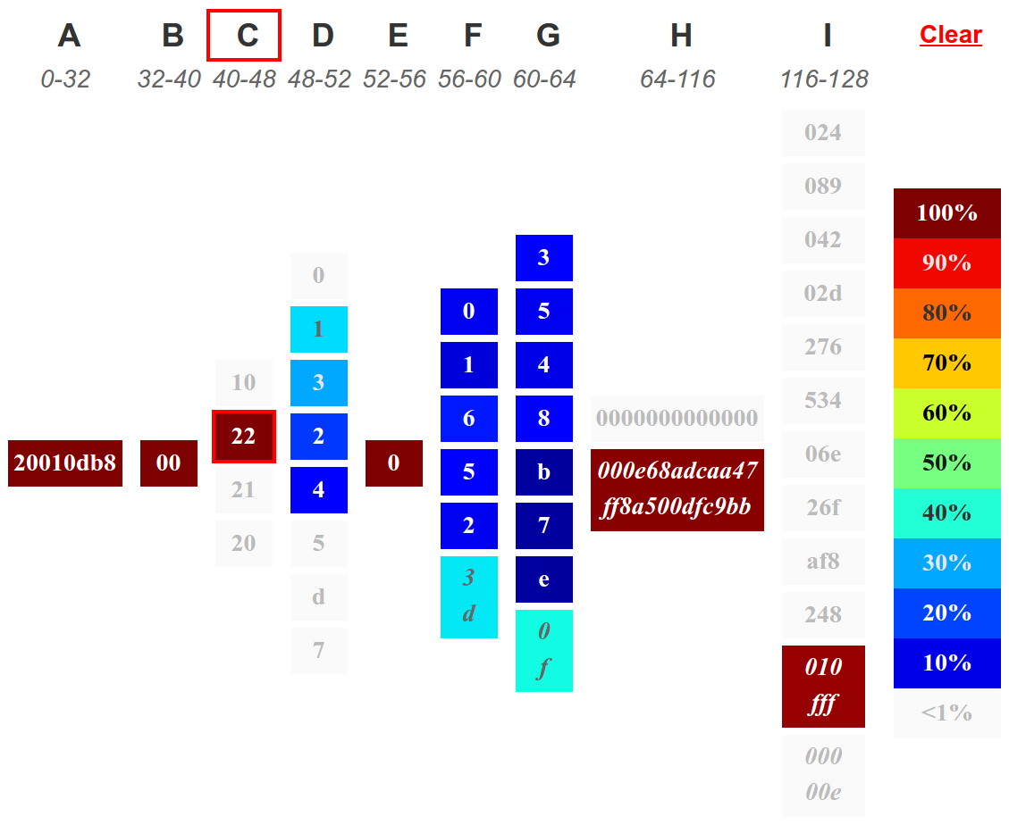
Bayesian Network: visualization (3)
condition on C2

Slide 17
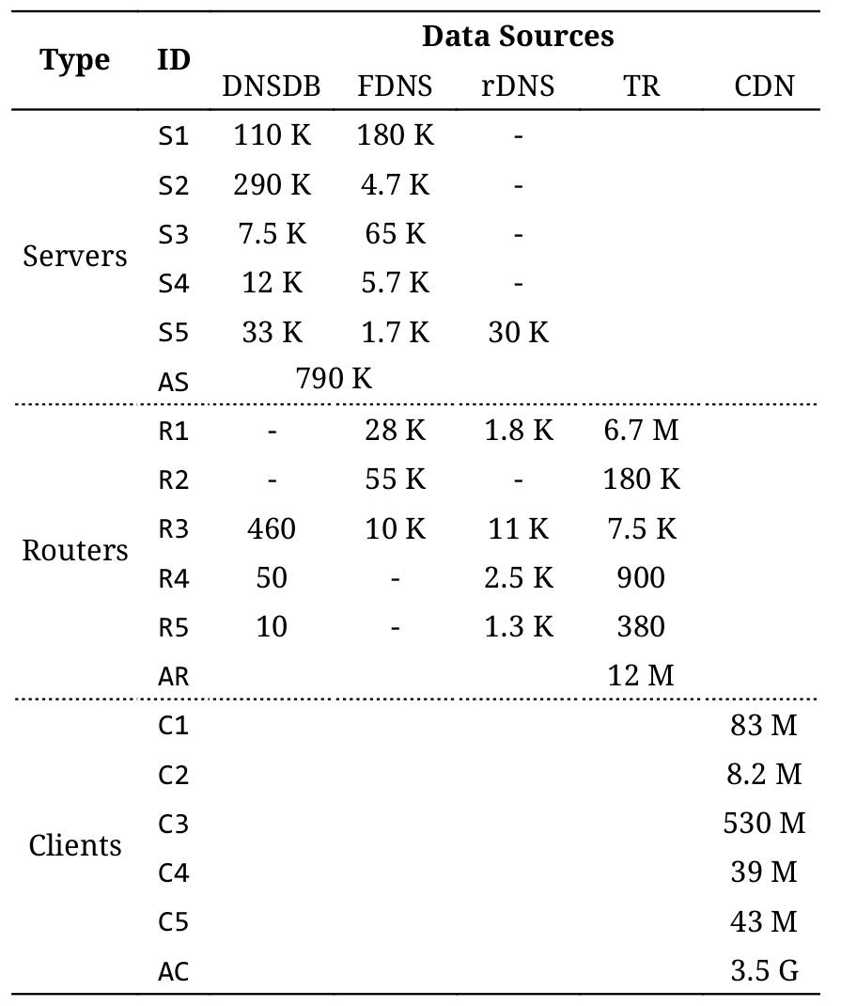
Evaluation: data
Q1 2016
3.5 billion IPs
DNS
Traceroutes
CDN logs

Slide 18
Evaluation: data
Q1 2016
3.5 billion IPs
DNS
Traceroutes
CDN logs

Slide 19
Evaluation: data
Q1 2016
3.5 billion IPs
DNS
Traceroutes
CDN logs
Notes:
What does eg. S1, R1, C1 mean? (one word)

Slide 20
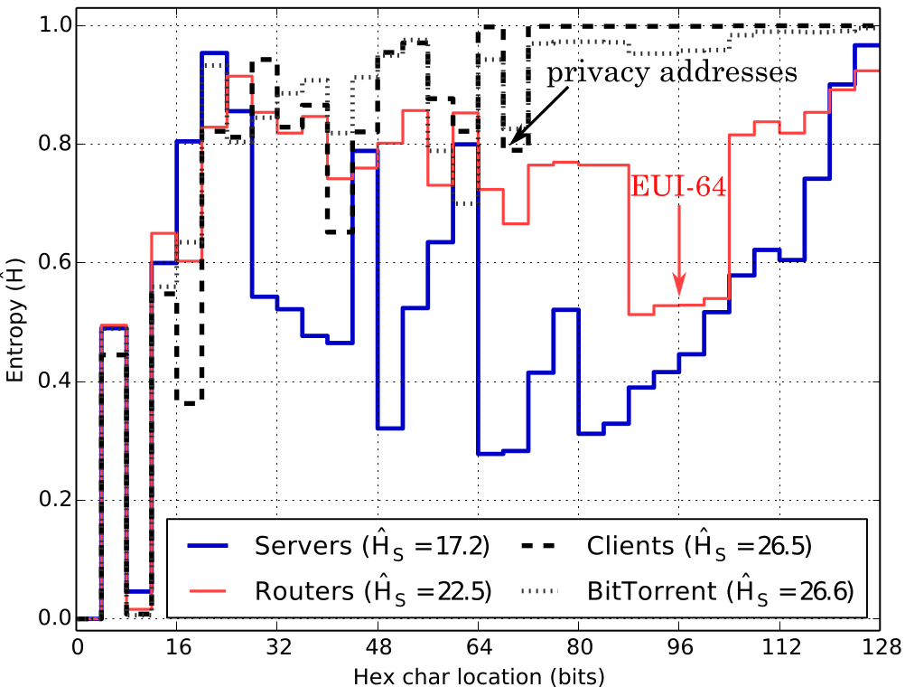
Aggregates
Notes:
Technique separates these classes (different information content characteristics)

Slide 21
Aggregates

Slide 22
Aggregates

Slide 23
Aggregates

Slide 24
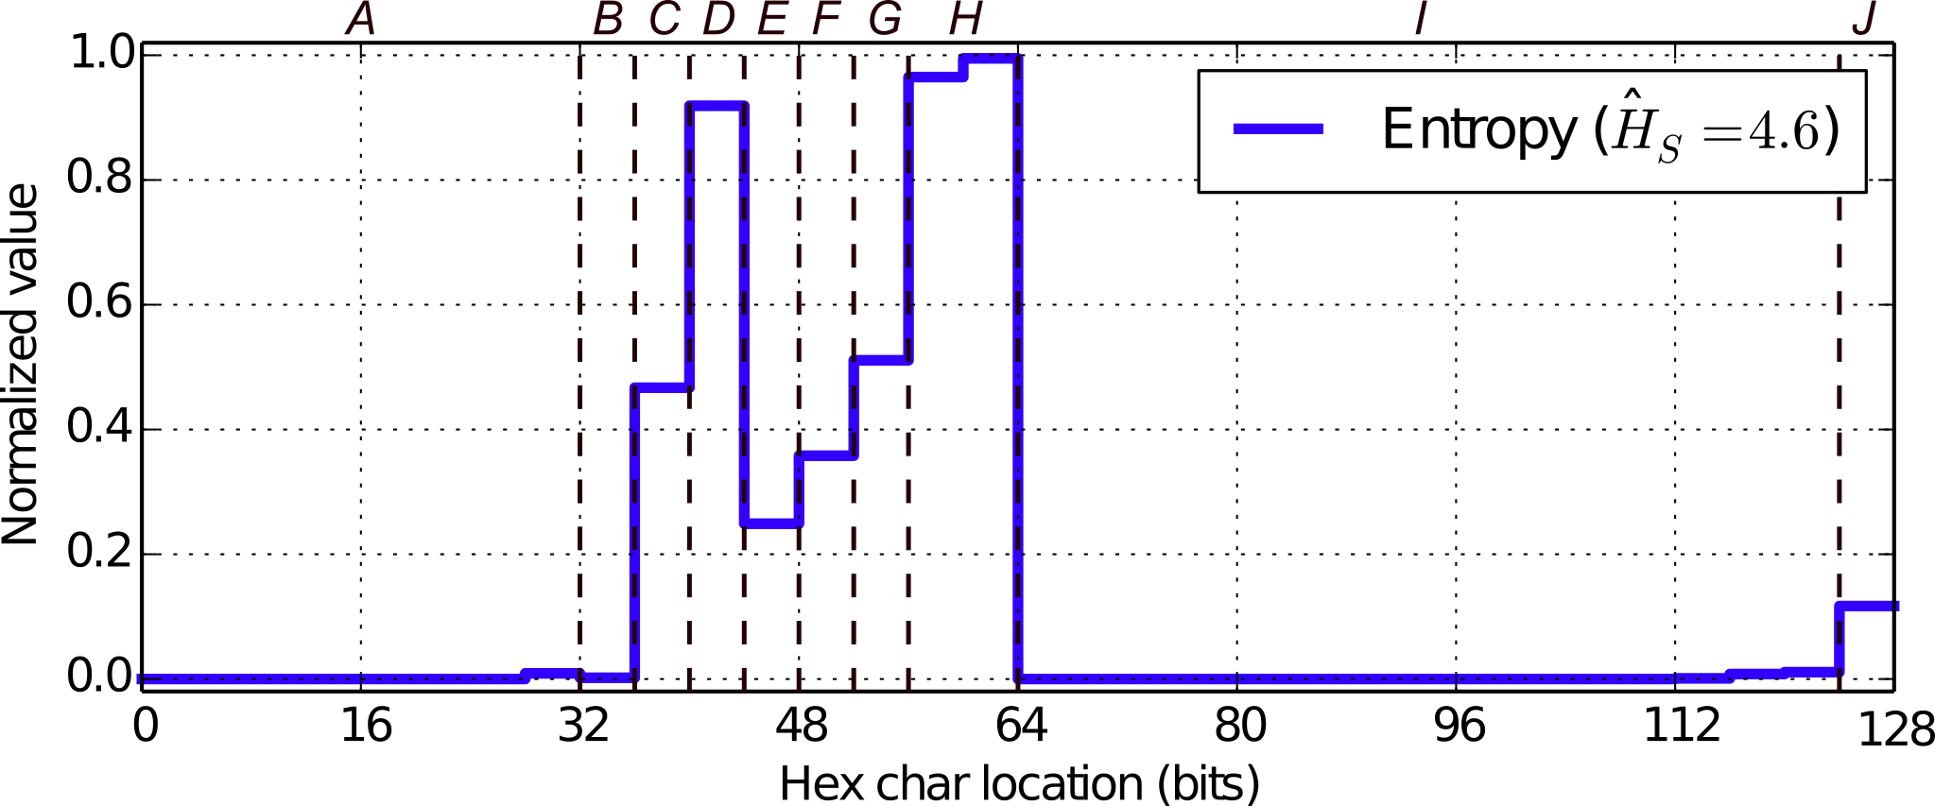
Evaluation: R1 (routers, global Internet carrier)

Slide 25
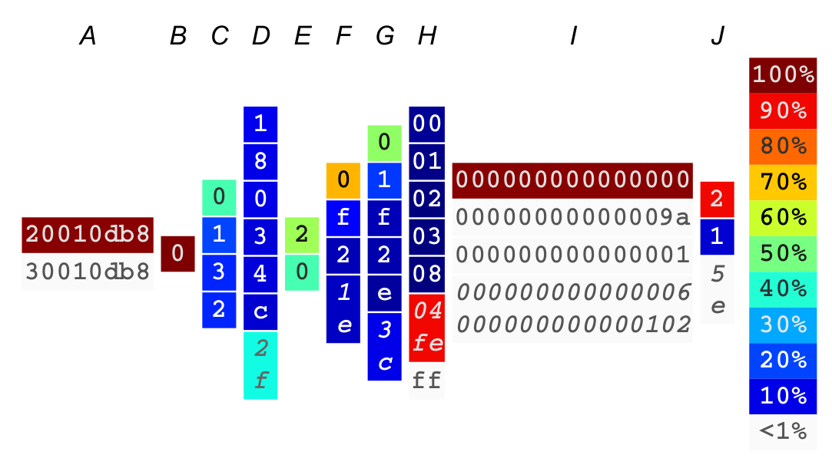
R1 (routers)

Slide 26
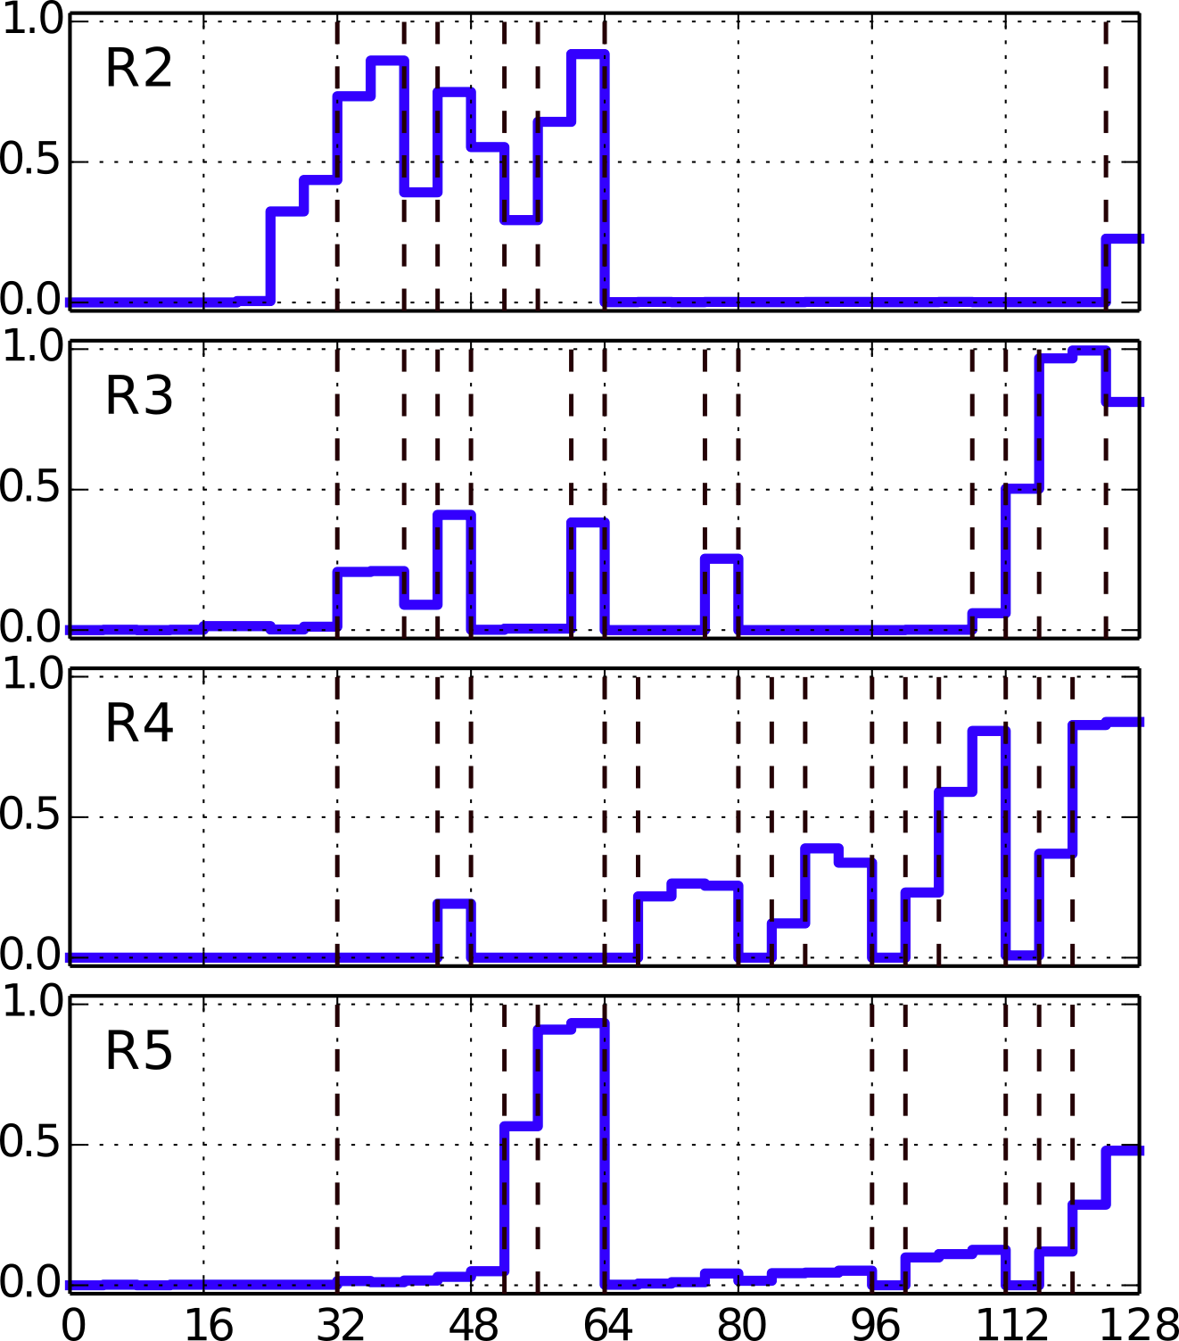
A. B. C. D
Routers (brief)
Notes:
R4: embeds IPv4 - highlight it / show it

Slide 27
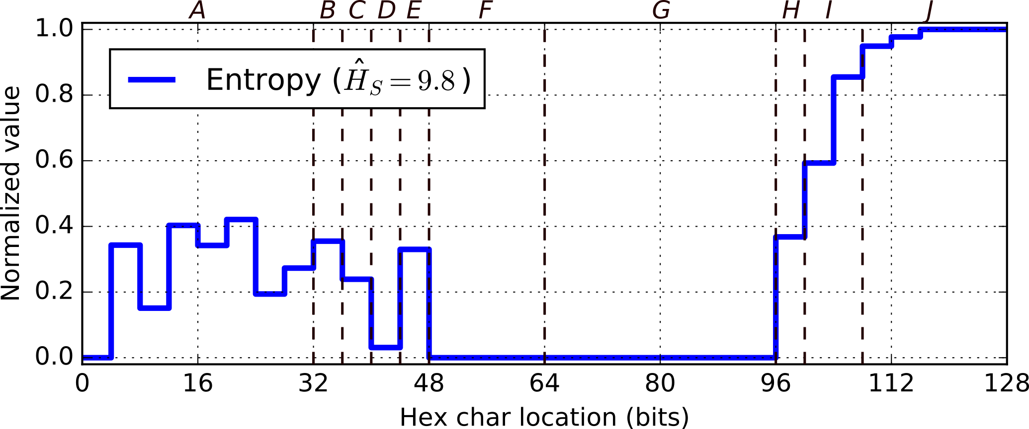
Evaluation: S4 (servers, leading cloud operator)

Slide 28
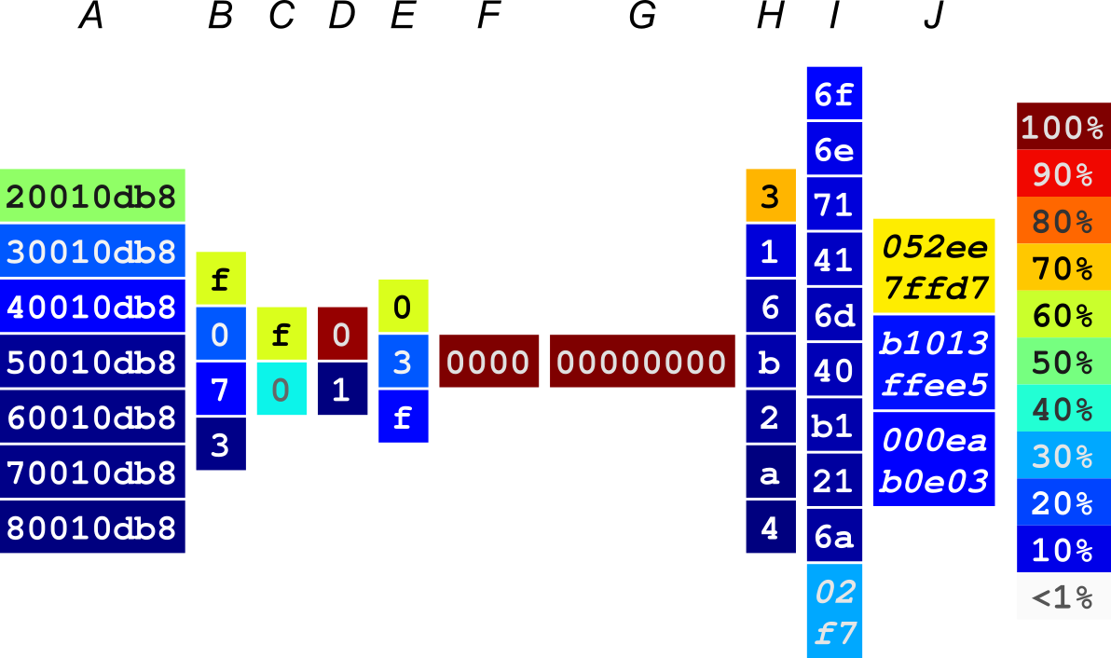
S4 (servers)

Slide 29
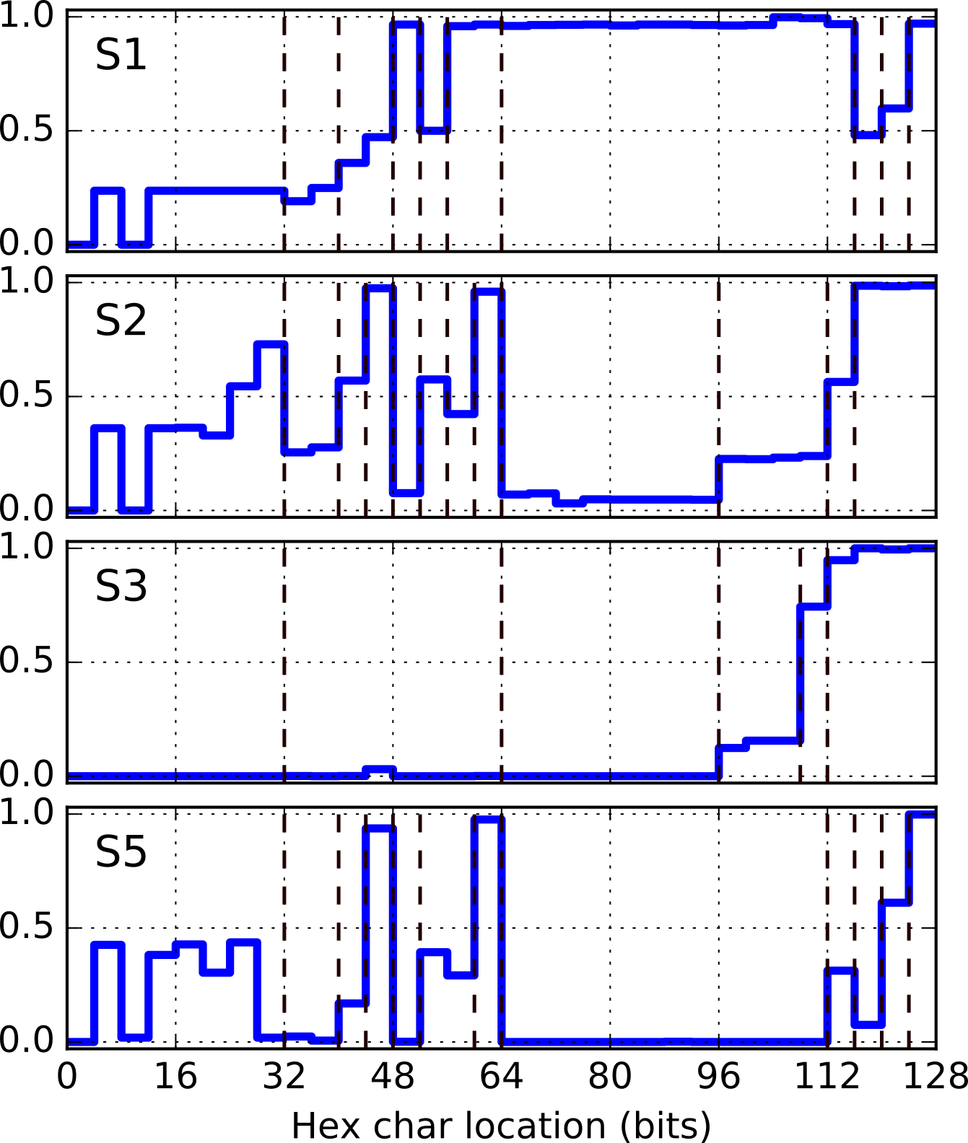
Servers (brief)
Notes:
Show S1 here as an exception - typically (with rare exceptions) servers don’t implement high-entropy IIDs
Explain that 64 bits is enormous

Slide 30
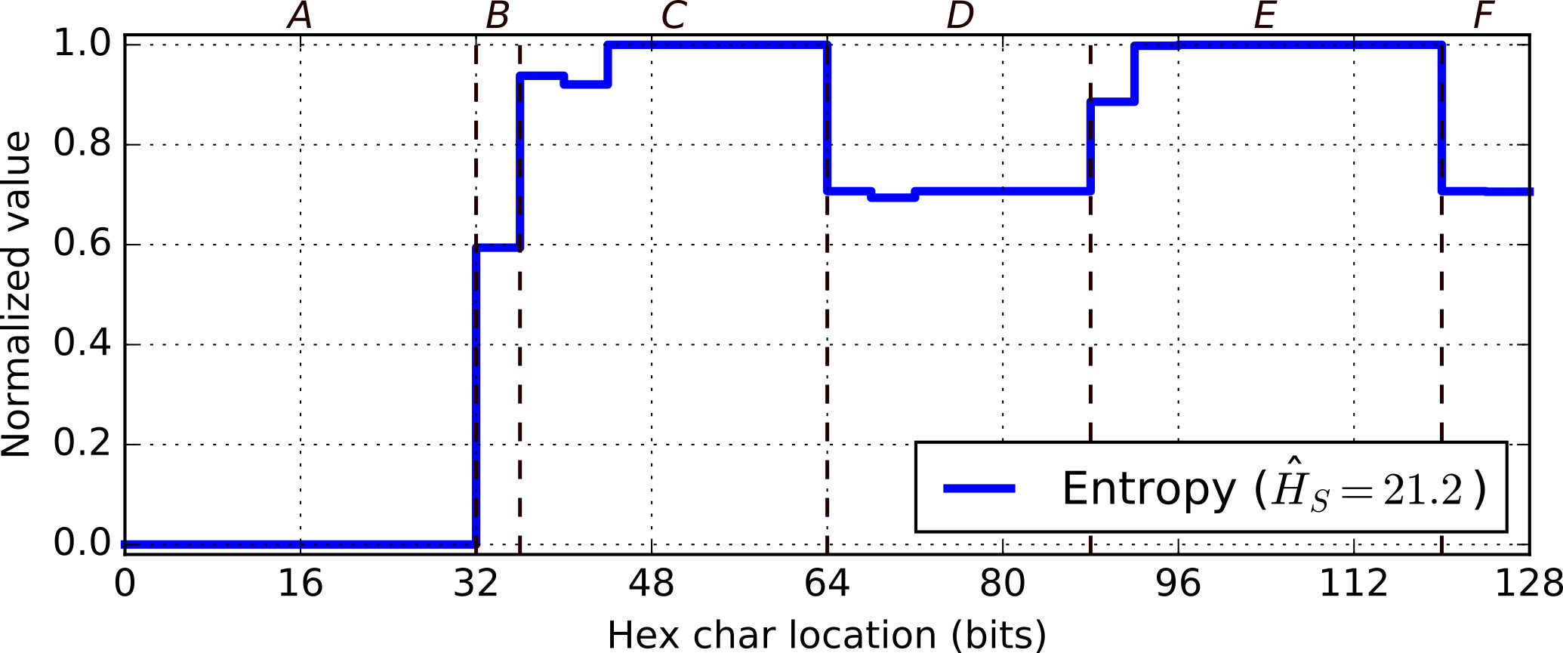
Evaluation: C1 (clients, large mobile operator)

Slide 31
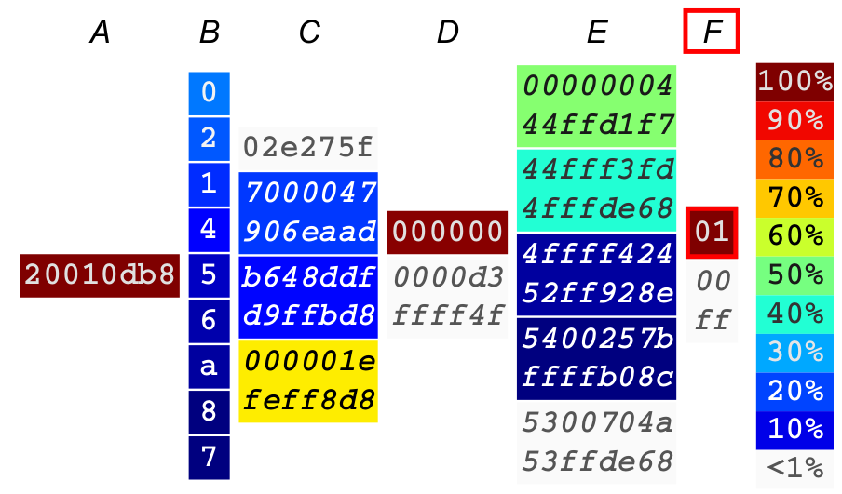
C1 (clients)
Notes:
Mention vulnerability to scanning (teach quickly before showing the scanning results)

Slide 32
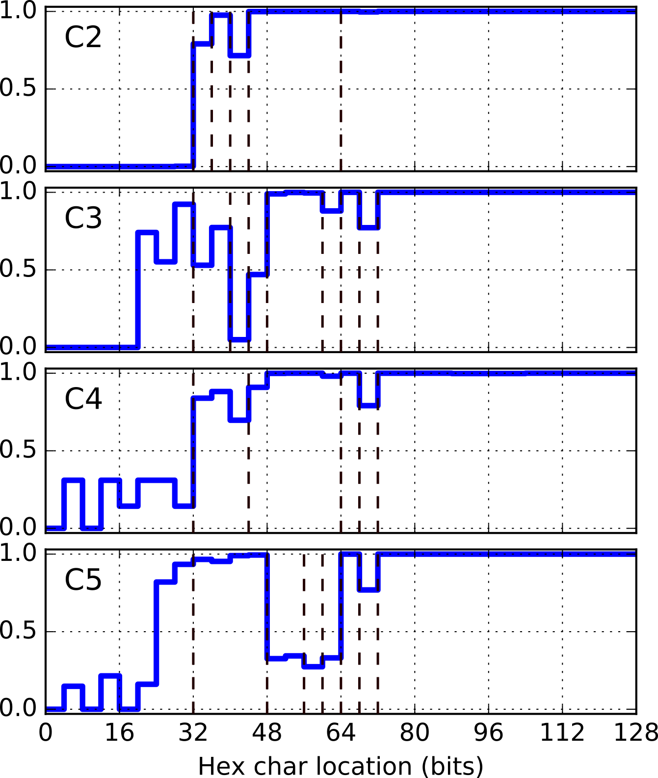
Clients (brief)

Slide 33
Scanning: experiment
Train on 1K samples
Evaluate on 1M generated candidates
Check number of valid addresses in:
Testing set
Ping requests
Reverse DNS

Slide 34
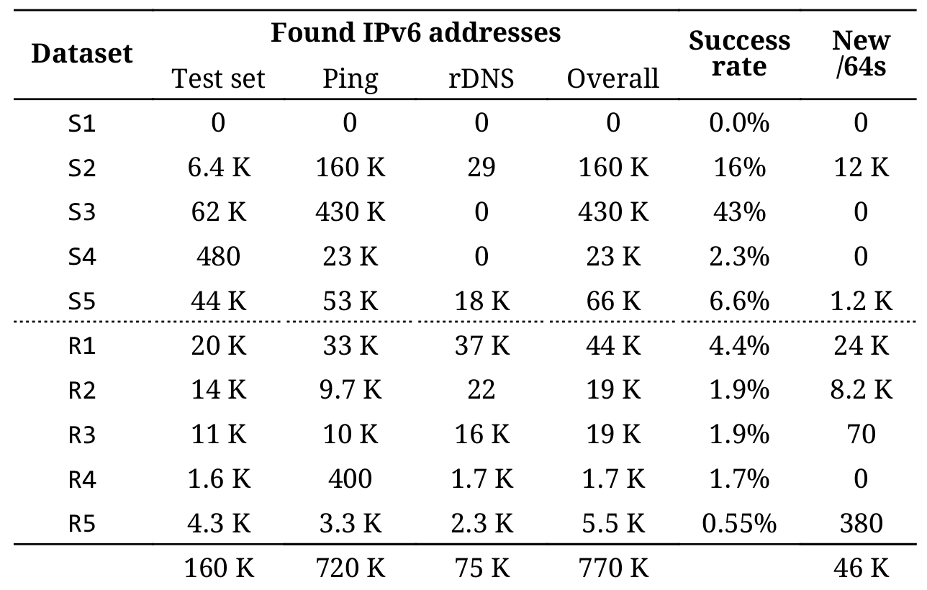
Scanning: Servers and Routers (1K sample)
Notes:
Highlight! Mention 1M tries - 43% is extremely high! Even single-digit is very high.
S1: operator practice, show relation to entropy plot

Slide 35
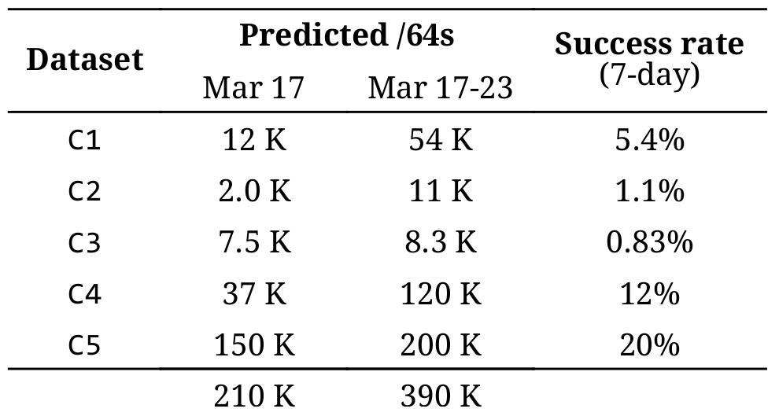
Discovering structure even in client networks
Notes:
Why not the whole address?
“No point in trying to guess” -> no sense to the audience - explain better (1 in 2^128)
“Vast majority of client IIDs are both pseudo-random and ephemeral” (except for minority: static, EUI-64, etc.)
“No prior work in the literature is trying to guess client IID”
There is still a value in discovering what’s above that - the /64s (e.g. traceroute campaigns)
Why would they want to know that?

Slide 36
Takeaways
IPv6 networks are scannable:
For most Server & Router networks we tried
For Clients, their network IDs are predictable
But… only to some degree (% success rate)
IPv6 addresses are structured
Can build probabilistic models for them (BNs)
Entropy uncovers semantically separate segments
Entropy/IP automatically learns IPv6 structures
Provides an interactive browser
Can generate targets for scanning
Can help in securing against scanning
Notes:
Mention C1 - was surprised - a check on structure

Slide 37
Takeaways #2
Hash-based load sharing
Algorithms should consider non-uniform distribution of “randomness” across 128 bits of IPv6 addresses
IPv6 network scanning
Implement pseudo-random, static network and interface identifiers (routers / servers)
Read Entropy/IP paper!
In-depth analysis of several real-world networks
Website: www.entropy-ip.com
Interactive IPv6 structure browser
IP address generator
Notes:
Mention C1 - was surprised - a check on structure

Slide 38
Thank You!
Entropy/IP: Uncovering Structure in IPv6 Addresses
www.entropy-ip.com
Paweł Foremski
Institute of Theoretical and Applied Informatics Email: pjf@iitis.pl Polish Academy of Sciences Twitter: @pforemski
Notes:
Leave as last slide shown

